Slide 1
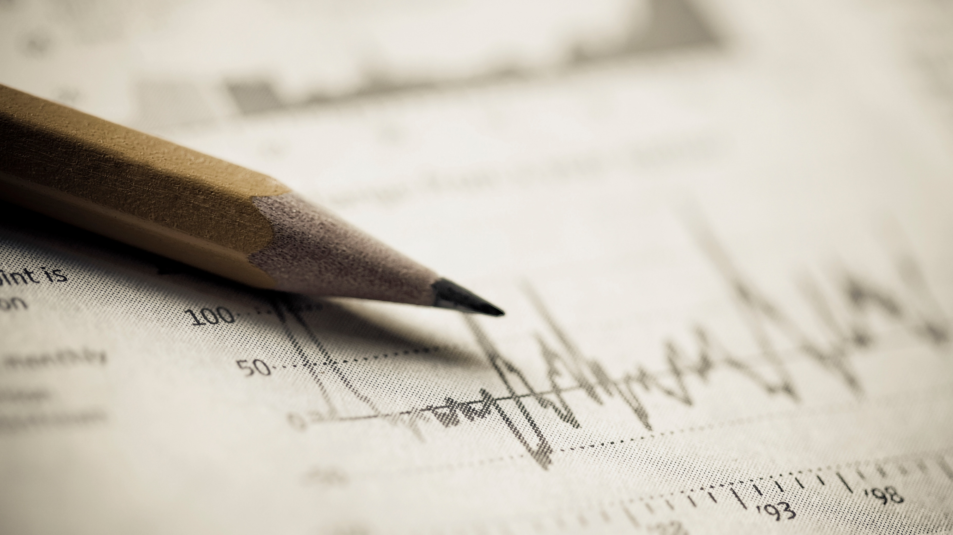
Assessing Defensive Line Value
Taylor Williams

Slide 2
Agenda
Background
Assumptions
Position Analysis
Rush Analysis
Pass Analysis
Conclusion
Future Work

Slide 3
Background – The Challenge
SportsInfoSolutions is hosting a contest to determine which Defensive Line positions have the most value in the National Football League
To facilitate that analysis, they provided play and player level data from the second half of the 2019 season
The data includes play level information including teams, scores, down, yards gained, play type, expect points added (EPA), rush direction, pass pressure, turnover, sack, etc.
The data also includes player level information for the defensive linemen on the field including player name, technique, side of the ball, tackle, pressure, sack, etc

Slide 4
Assumption – Gap Assignment
The first main assumption made in this analysis concerns defensive line gap assignments
On each play a player is in a certain Technique that is based on where they line up relative to the Offensive Linemen
Based on where they line up, they have responsibility to cover one or two gaps (spaces between the OL)
Defensive Right
OB
Defensive Left
OS
9
6
7
5
4
4i
3
2
2i
1
0
1
2i
2
3
4i
4
5
7
6
9
OS
Line of Scrimmage
TE
T
G
C
G
T
TE
Gap with responsible DL boxed
D
C
B
A
M
A
B
C
D
Offensive Left
QB
Offensive Right

Slide 5
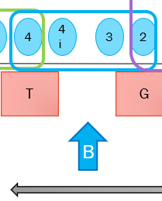
Assumption – Gap Assignment
The diagram on the previous slide depicts how gap assignment was assessed in the rushing game
For example, if a rush goes to the Left B Gap, any Defensive Linemen at the following Side of Ball and Technique combinations would be given a “Gap Opportunity”:
Right 4
Right 4i
Right 3
Right 2

Slide 6
Assumption – Gap Opportunity
A Gap Opportunity is counted when a rush is designed to go to a gap that a DL should be covering
In the previous example, if a DL is lined up at the Right 3 Tech and the offense’s play is designed to rush towards the Left B Gap, that specific DL gets a Gap Opportunity and we would say that gap is covered on the play. A DL at the Left 7 Tech for instance, would not get a Gap Opportunity on that play
If the rusher then doesn’t use the designed gap, the DL with a Gap Opportunity is credited with forcing a gap change. If there are more than one DL with a Gap Opportunity, they’re both credited

Slide 7
Assumption – EPA & Success
Expected Points Added (EPA) is a value assigned to each play that measures the number of points a play added for the offense on an average basis
It’s based on a regression of all plays that calculates the difference in expected points for the drive before a play and after a play – the difference is the expected points added on that play
If an offense completes a big pass, the expected points on that drive go up. That positive difference is the EPA for that play. Likewise if a QB gets sacked, the expected points go down with a negative EPA.
EPA is a well tested, stable measure of play value
A play is a Success for the offense if the EPA for a play is positive
For this analysis, we default to EPA to determine how valuable an action was from either the offense or defense. The perspective is from the offense, so the higher the EPA, the worse it is for the defense

Slide 8
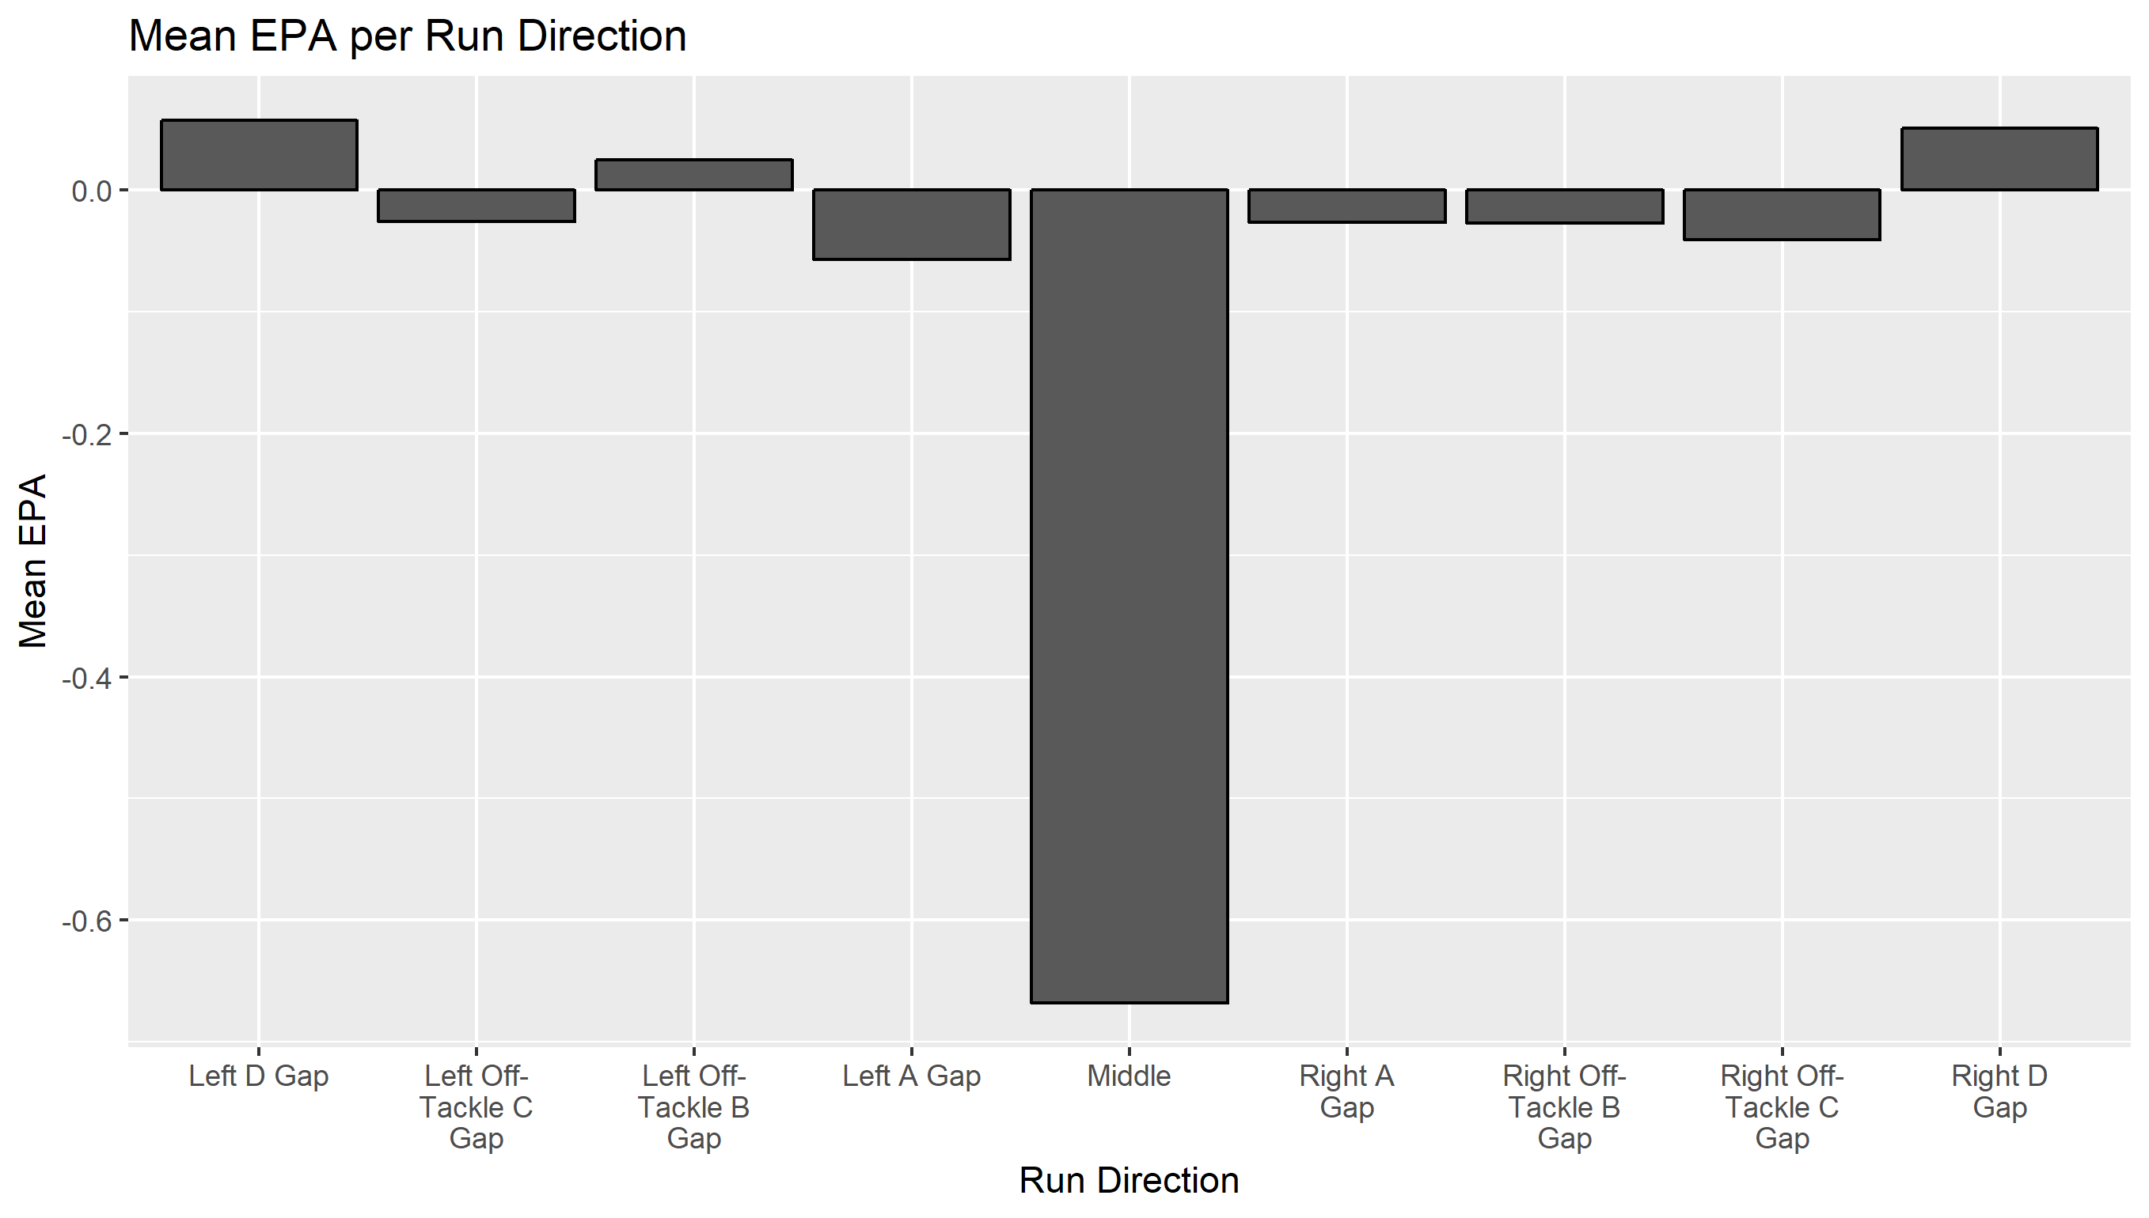
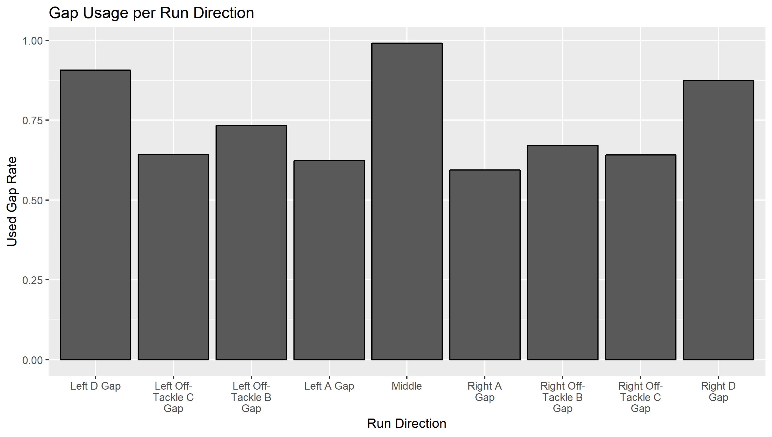
Assumption – Side of Ball
In the rushing game, there are identical gaps on each side of the ball. However, there doesn’t appear to be a significant difference for which side of the field a particular gap is targeted for a run
As a result, future analysis in this presentation will ignore which side a rush goes to and only look at gap

Slide 9
Assumption – Game State
Several metrics are tested against game state conditions
Game state was defined using the score differential at the beginning of the play as follows:
2 = Large offensive lead (> 10 points)
1 = Slight offensive lead (> 3 points)
0 = Close game (within 3 points)
-1 = Slight defensive lead (> 3 points)
-2 = Large defensive lead (> 10 points)

Slide 10
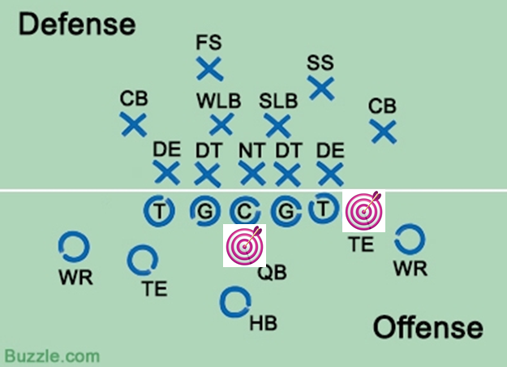
Position Analysis

Slide 11
Defensive Line Clustering
There are typically 3-5 Defensive Linemen on the field for each play, but there are 11 Techniques on each side of the ball plus 2 in the middle
DL’s typically play multiple different Techniques throughout a game
Using K-Means clustering on snap rate per Technique and roster position, we can group players according to where they tend to play and assign one position to each player who played enough snaps in the sample
4 clusters produced the best results with intuitive positions as the output

Slide 12
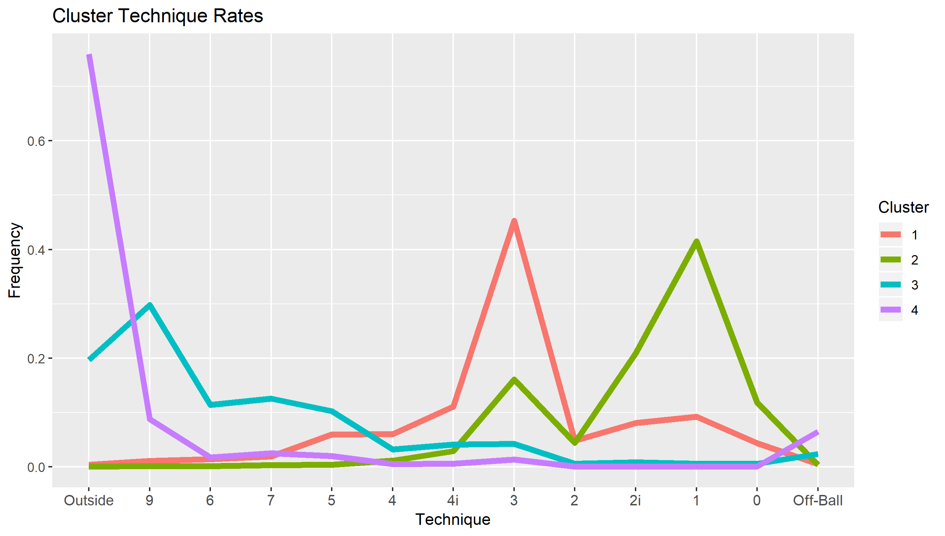
Cluster Snap Rates
Each cluster was focused on certain techniques where the majority of the players’ snaps were taken
Cluster Names:
Cluster 1 = Middle 3 Tech
Cluster 2 = Inside 1 Tech
Cluster 3 = End DL
Cluster 4 = Outside non-DL

Slide 13
Defensive Positions
Going forward these are the positions used to group players
Any player that didn’t register enough snaps on the defensive line was given a “non-standard” label
These players tended to be defensive backs and linebackers who weren’t asked to play on the line often

Slide 14
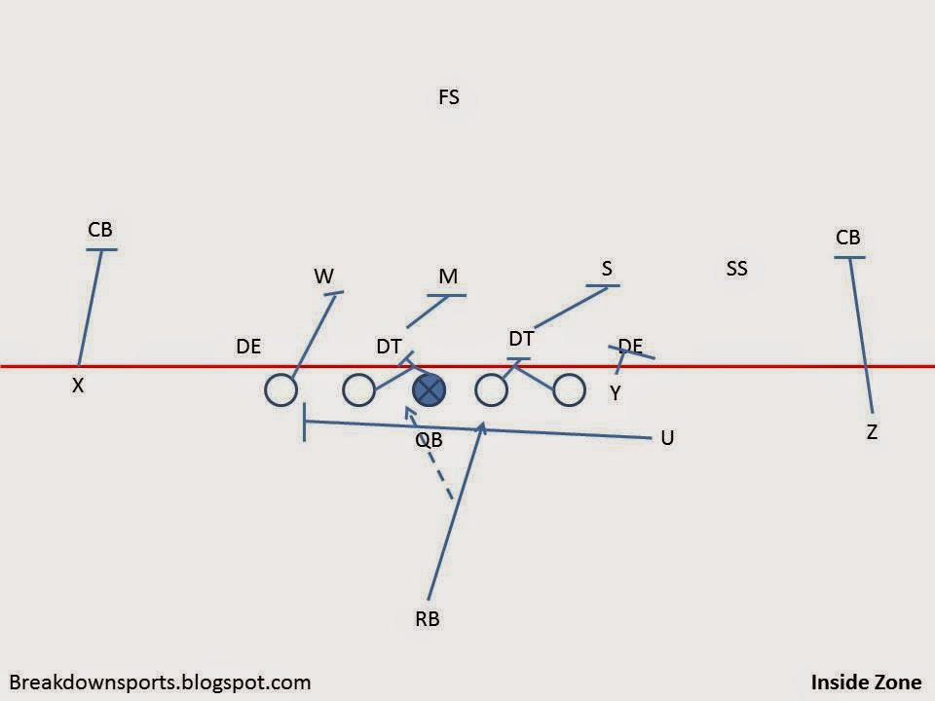
Rushing Analysis

Slide 15
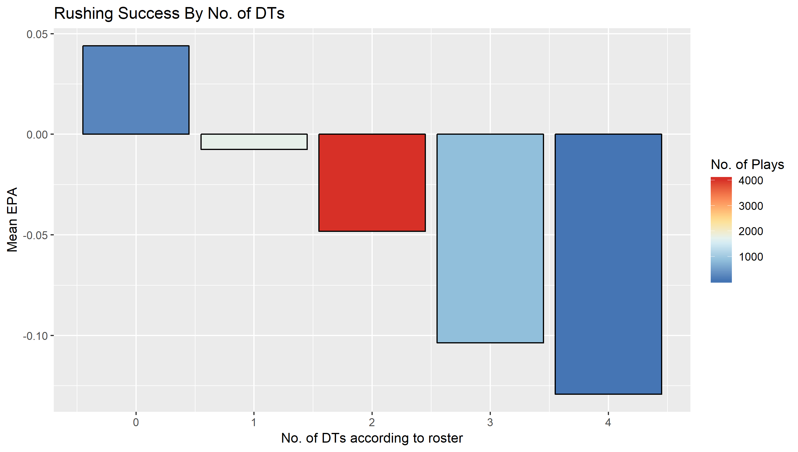
Roster Position Analysis – DT’s
To begin with, we start by looking at rush success based on the number of DL’s on the field with Defensive Tackle designation on the roster. Note this does not mean they lined up as a DT necessarily
As the D-Line loads up on more Defensive Tackles, they become increasingly stronger against the run
The vast majority of the plays however come with 2 on the field
Gap usage rates (how often a rush used the designed gap) was not affected by number of DT’s on the field

Slide 16
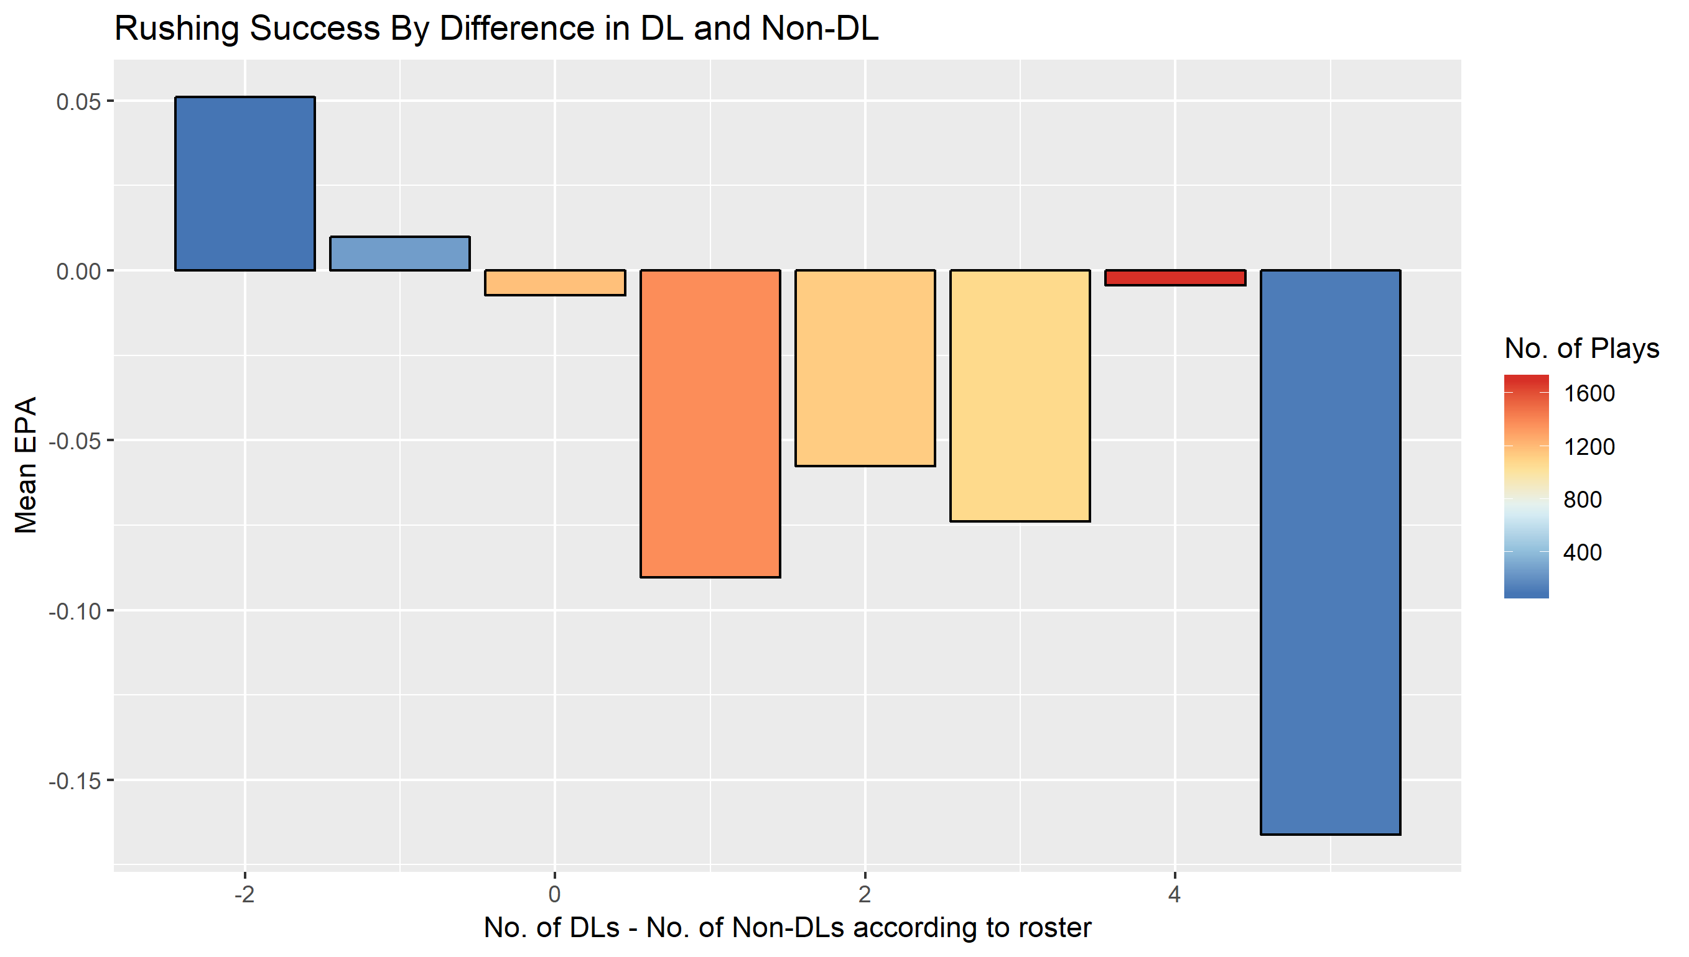
Roster Position Analysis – Non-DL’s
On most plays there are non Defensive Lineman (by roster) who line up on the line. The distribution of true DL’s vs non-DL’s also matters for rushing success
The most common defensive alignment is 4 more DL’s than non-DL’s. However that is one of the worst performing configurations
Teams are much better off against the run by having a non-zero number of non-DL’s to shift the ratio to +1, 2, or 3 DL’s to non-DL’s

Slide 17
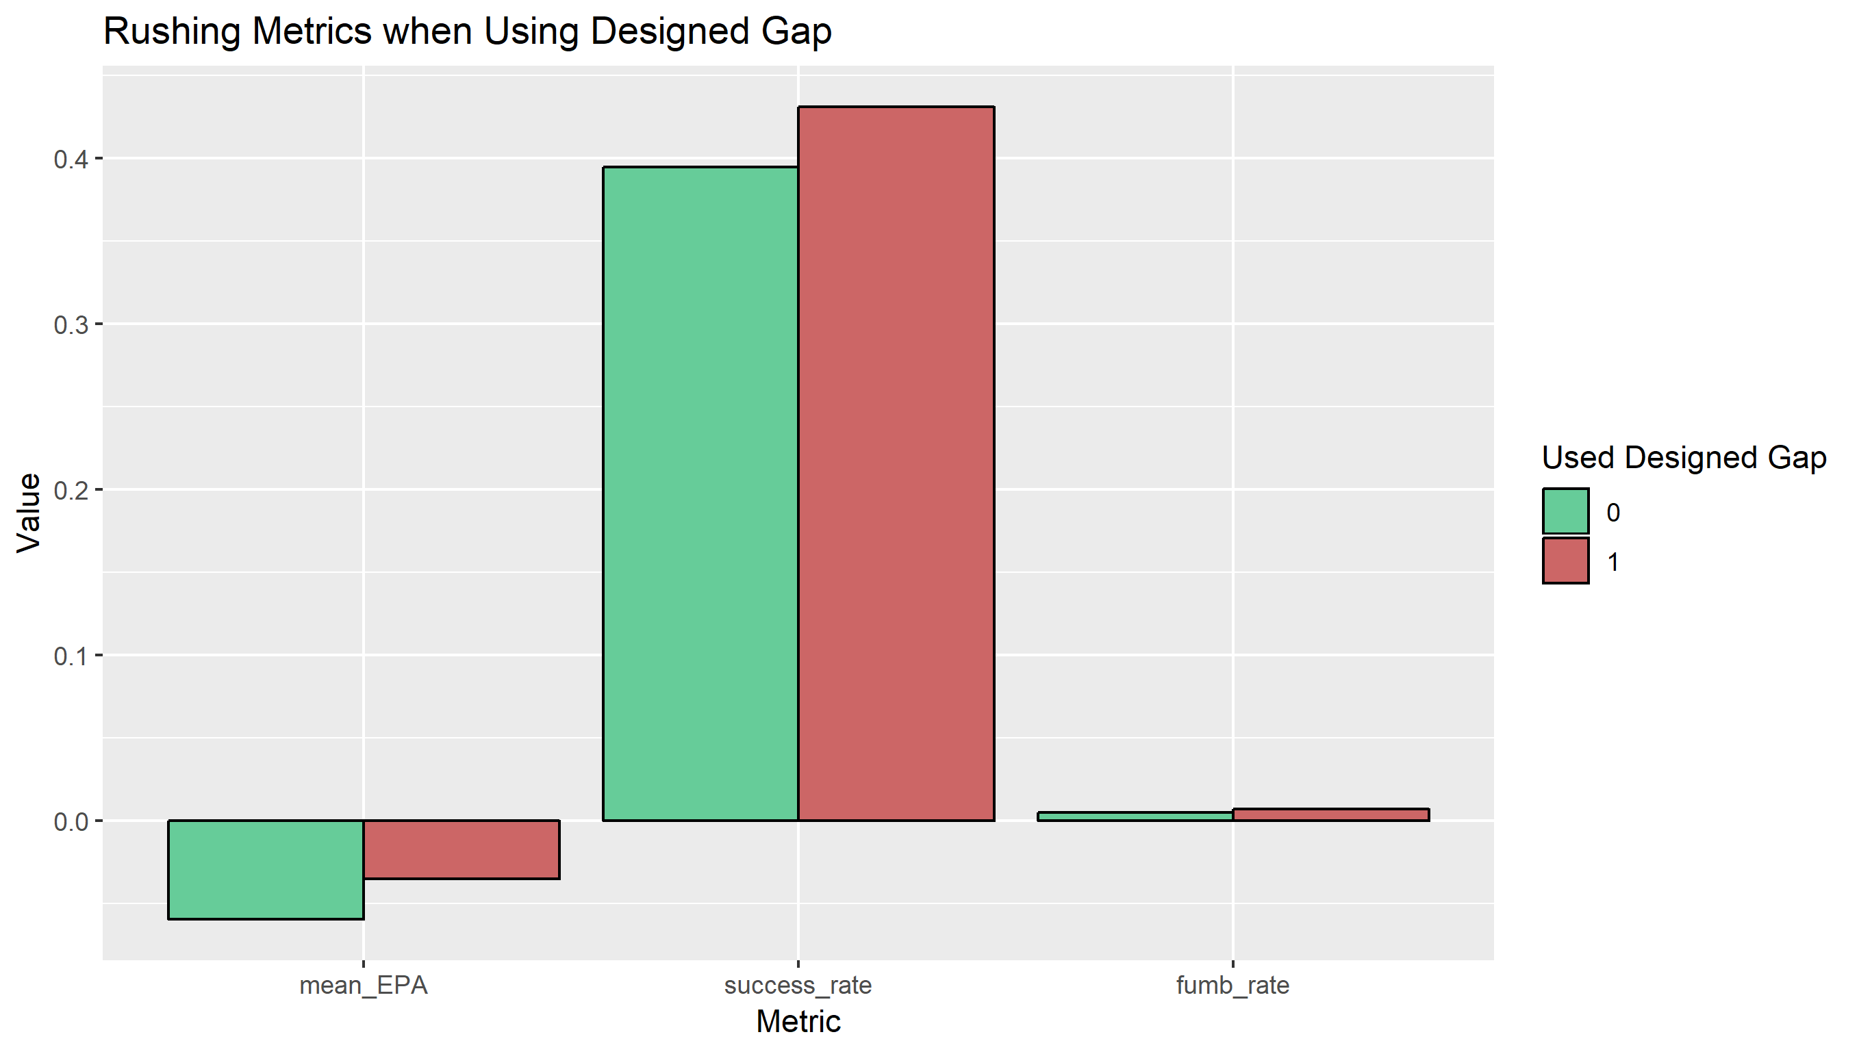
How to be successful against the run
Defenses decide which positions to play and at what technique. The goal should be to force rushers to not use the designed gap
Defense is inherently at a disadvantage given they have to respond to the offense’s actions
Forcing the offense to change its plan and not do what the play was designed to do results in a higher likelihood of wins for the defense in terms of average EPA and Success Rate

Slide 18
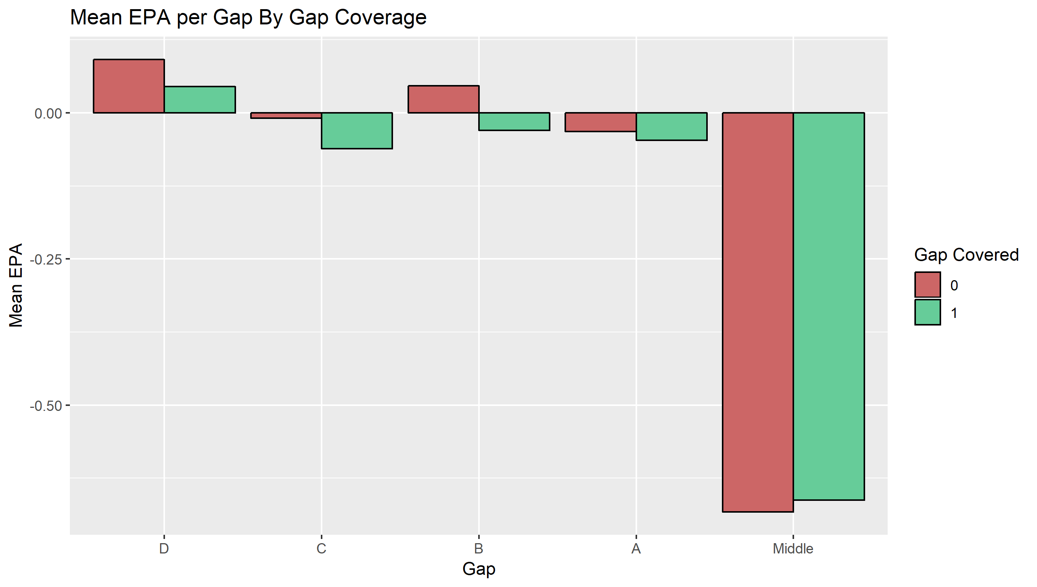
Covering the Gaps
The defense’s goal in the run game should be to force the rusher to use a different gap than designed
The best way to force a gap change is to have the gap covered ahead of the snap
Having the B Gap covered results in the largest EPA boost for the defense when a rush goes to that gap flipping the average play from a successful play for the offense to unsuccessful
B Gaps are the responsibility of the Middle 3 Tech position most often, so having them on the field makes the biggest difference when called upon

Slide 19
Forcing Gap Changes
As shown earlier in the Side of Ball Assumption, the likelihood of forcing a gap change varies depending on the gap (but not which side of the ball).
Interior A-C Gaps are the easiest to force a change. Runs in those gaps use the designed gap 60-70% of plays
It’s much harder for both outside (89% used gap rate) and up the middle (99%) rushes to be forced out of their gap
The effect of forcing that change also varies depending on the gap

Slide 20
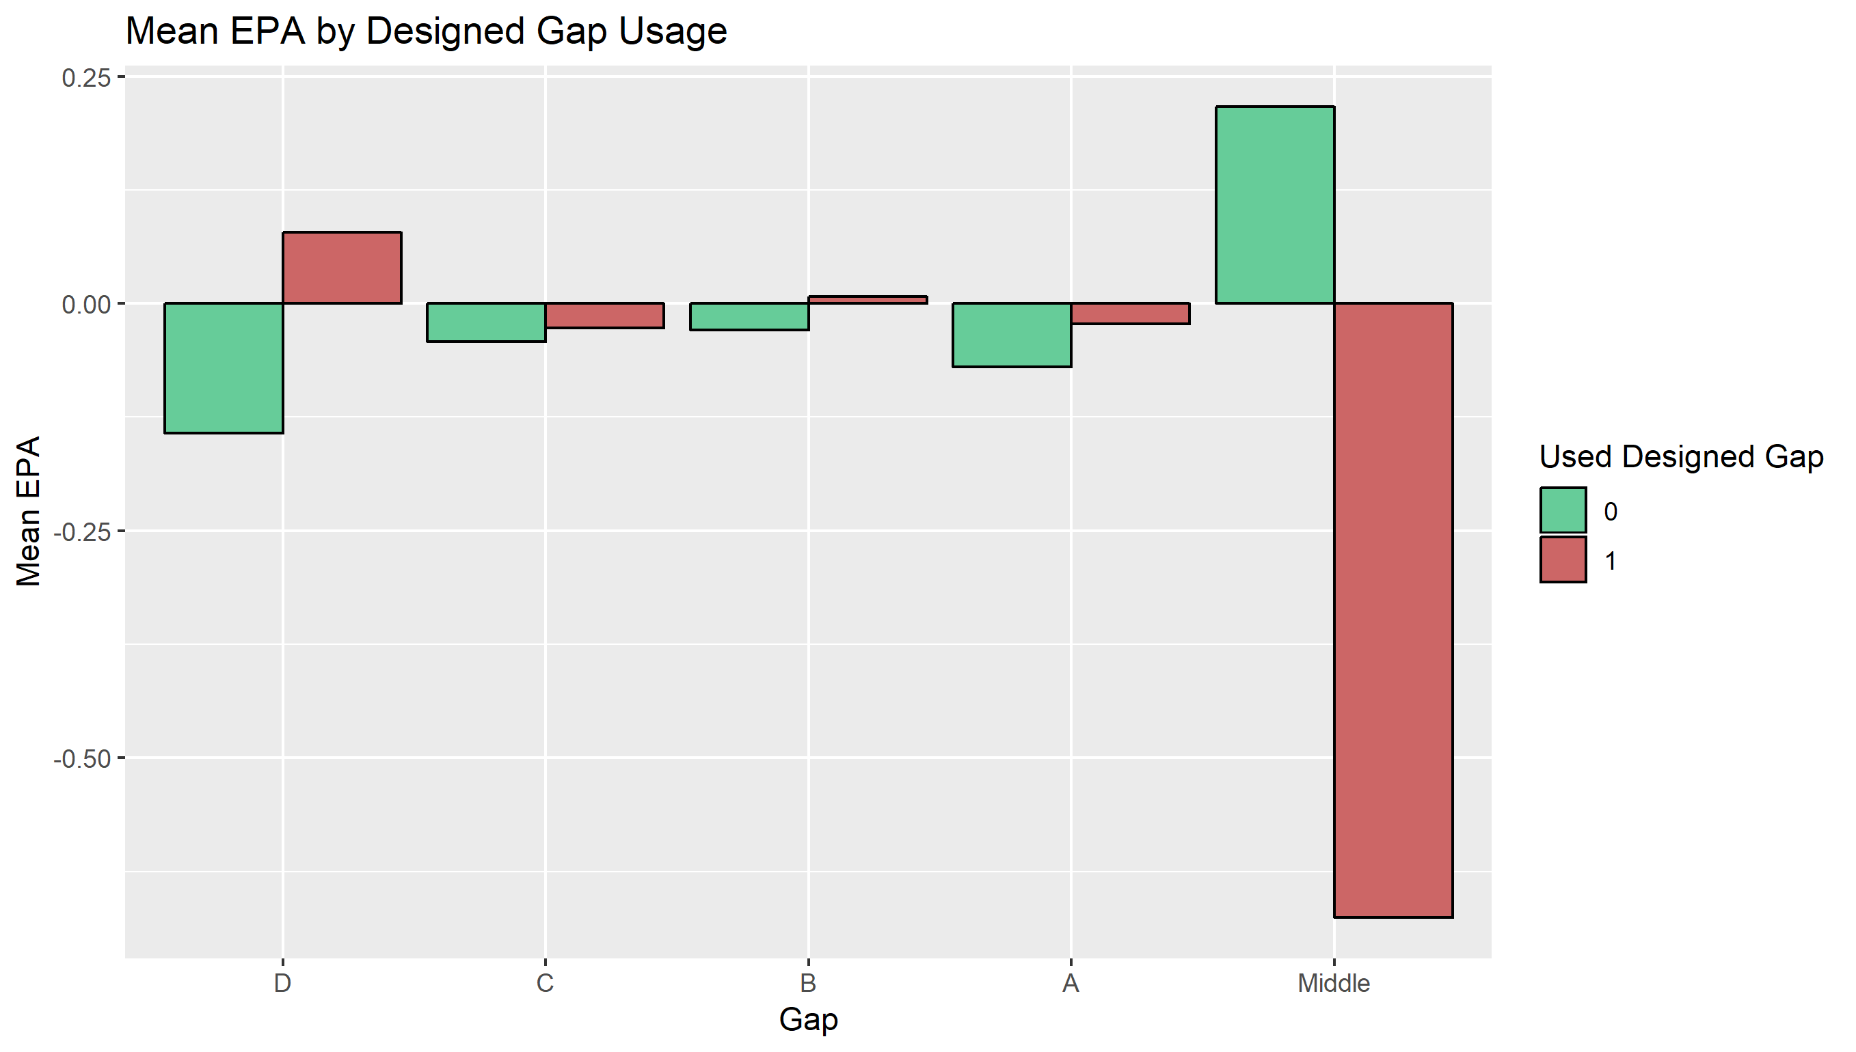
Forcing Gap Changes
When rushes are designed to go to either the D or B gap, forcing the rusher to another gap results in large increase in value for the defense
Rushes go from positive EPA for the offense to negative
Rushes to the middle fair very poorly from an EPA perspective. The gap is almost never changed and is actually worse for the defense if it is

Slide 21
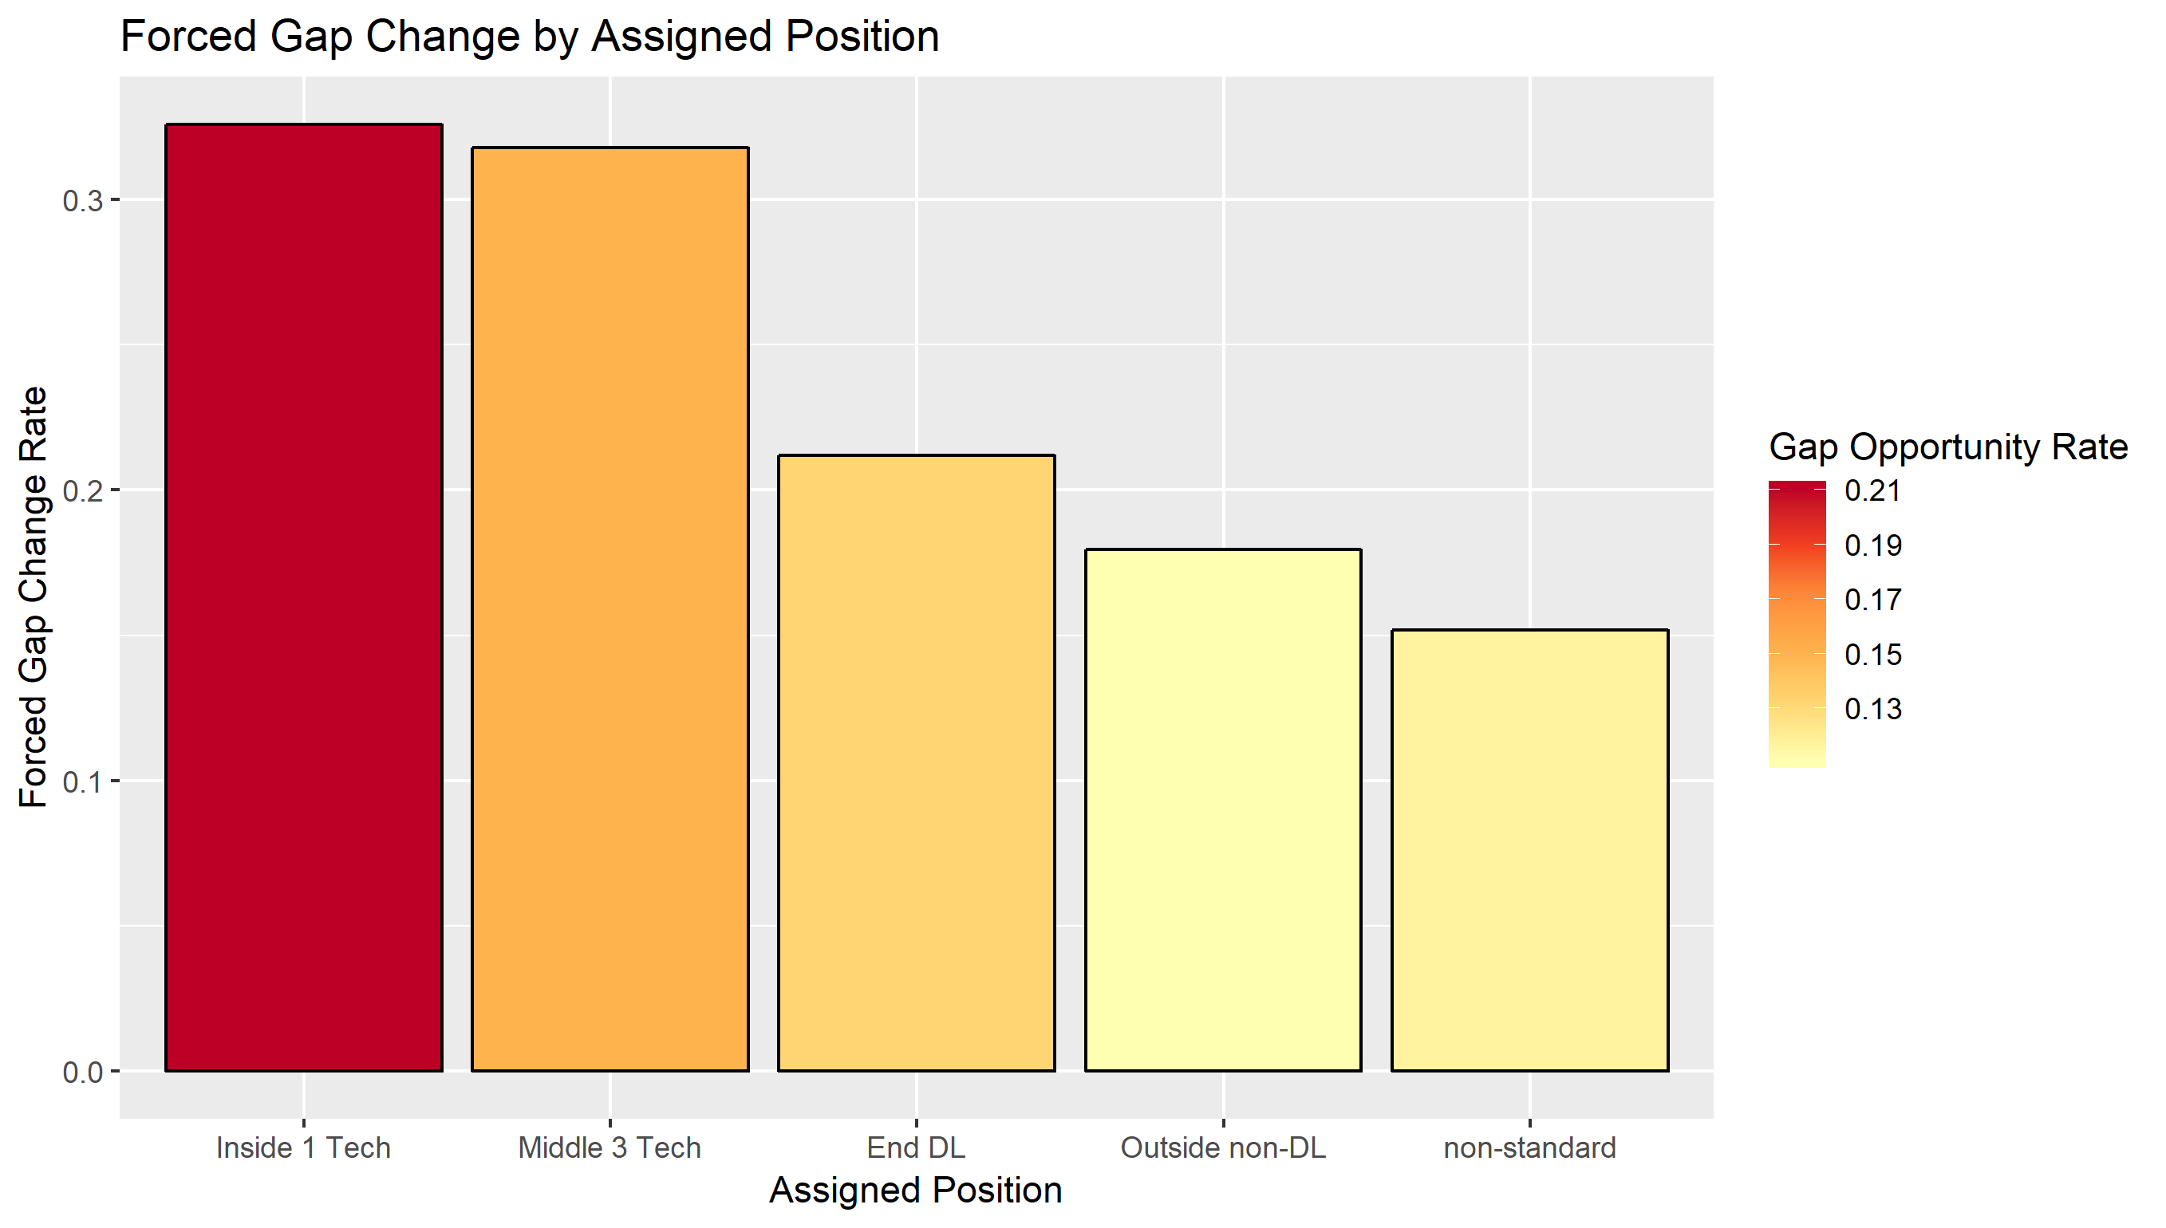
Who forces gap changes
With the Gap Opportunity and Used Designed Gap framework, we can see which positions are better at forcing gap changes when given the chance
Our Inside 1 and Middle 3 Tech positions are both getting more Gap Opportunities and forcing gap changes more frequently when getting an opportunity
This is consistent with A-C gap rushes being forced out of their designed gaps the most

Slide 22
Positional Talent Distribution
We saw that the inside positions on the whole force the gap changes most frequently.
However in order to assess the value the position brings, we need to judge the distribution of talent at the position.
To take an extreme example, if every Inside 1 Tech forced exactly 25% gap changes, there would be no reason to pay one Inside 1 Tech more than another.
On the other hand, if the average is 20%, but the elite few force 40% gap changes, that’s incremental value worth investing in

Slide 23
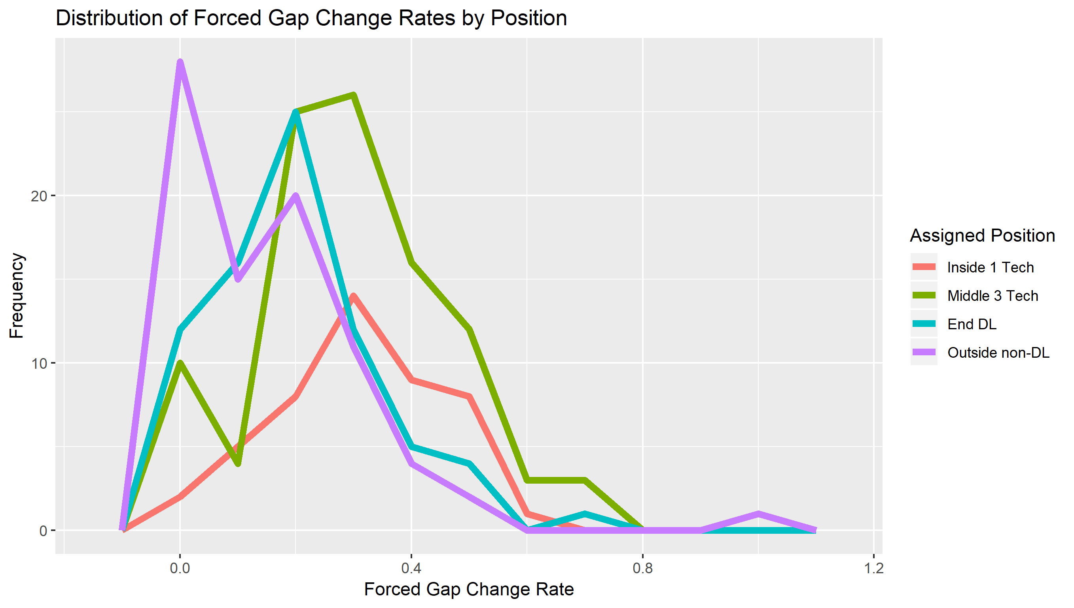
Positional Talent Distribution
This chart tells us the Middle 3 Tech position has the widest range of individual players’ forced gap change rates
Inside 1 Tech is next while the outside DL’s tend to be more narrowly distributed
In the run game, outside DL’s don’t differentiate themselves as much as their inside counterparts

Slide 24
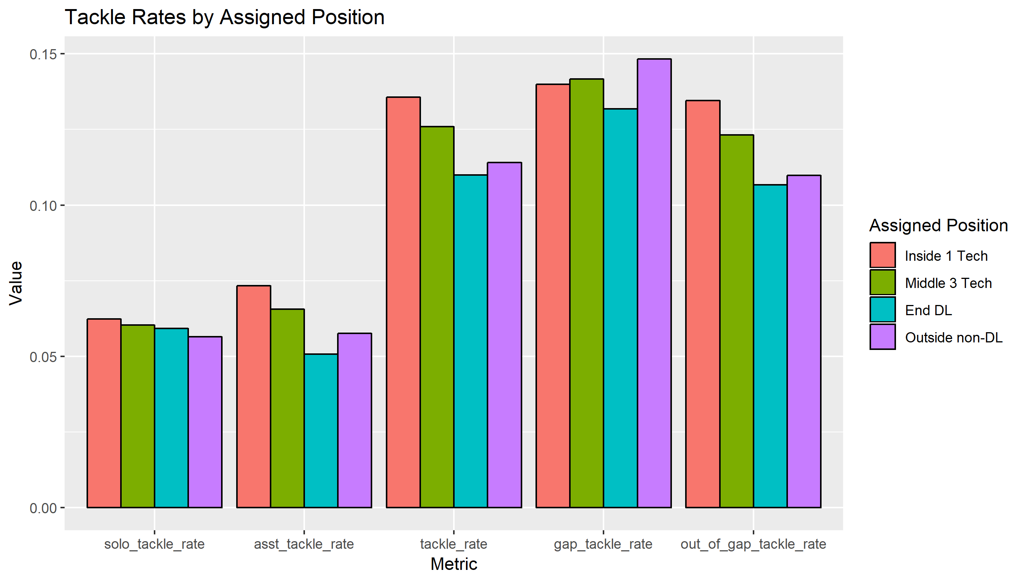
Tackle Rates
To this point we have been focusing on EPA effects, but it’s worth noting how tackling occurs
Overall, the interior positions get more tackles, but that increase is fueled by assisted tackles
The Outside DL’s also tend to have less tackles on runs outside of their gap suggesting they aren’t asked to go inside to make tackles

Slide 25
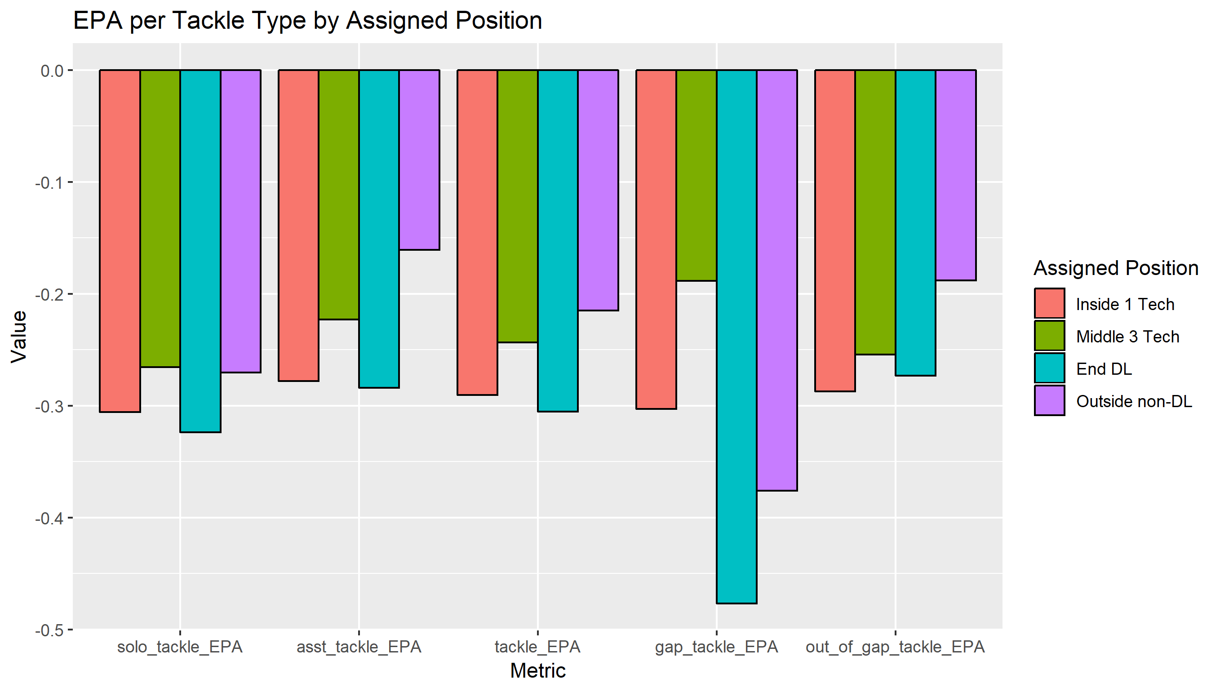
Tackle Value
The value of a tackle is roughly constant across the positions with a slight edge to Inside 1 and End DL’s
However the largest discrepancy here is when a tackle is made by an outside player on a run to their gap
Outside players don’t typically have much help on outside runs, so they are critical to stopping big plays

Slide 26
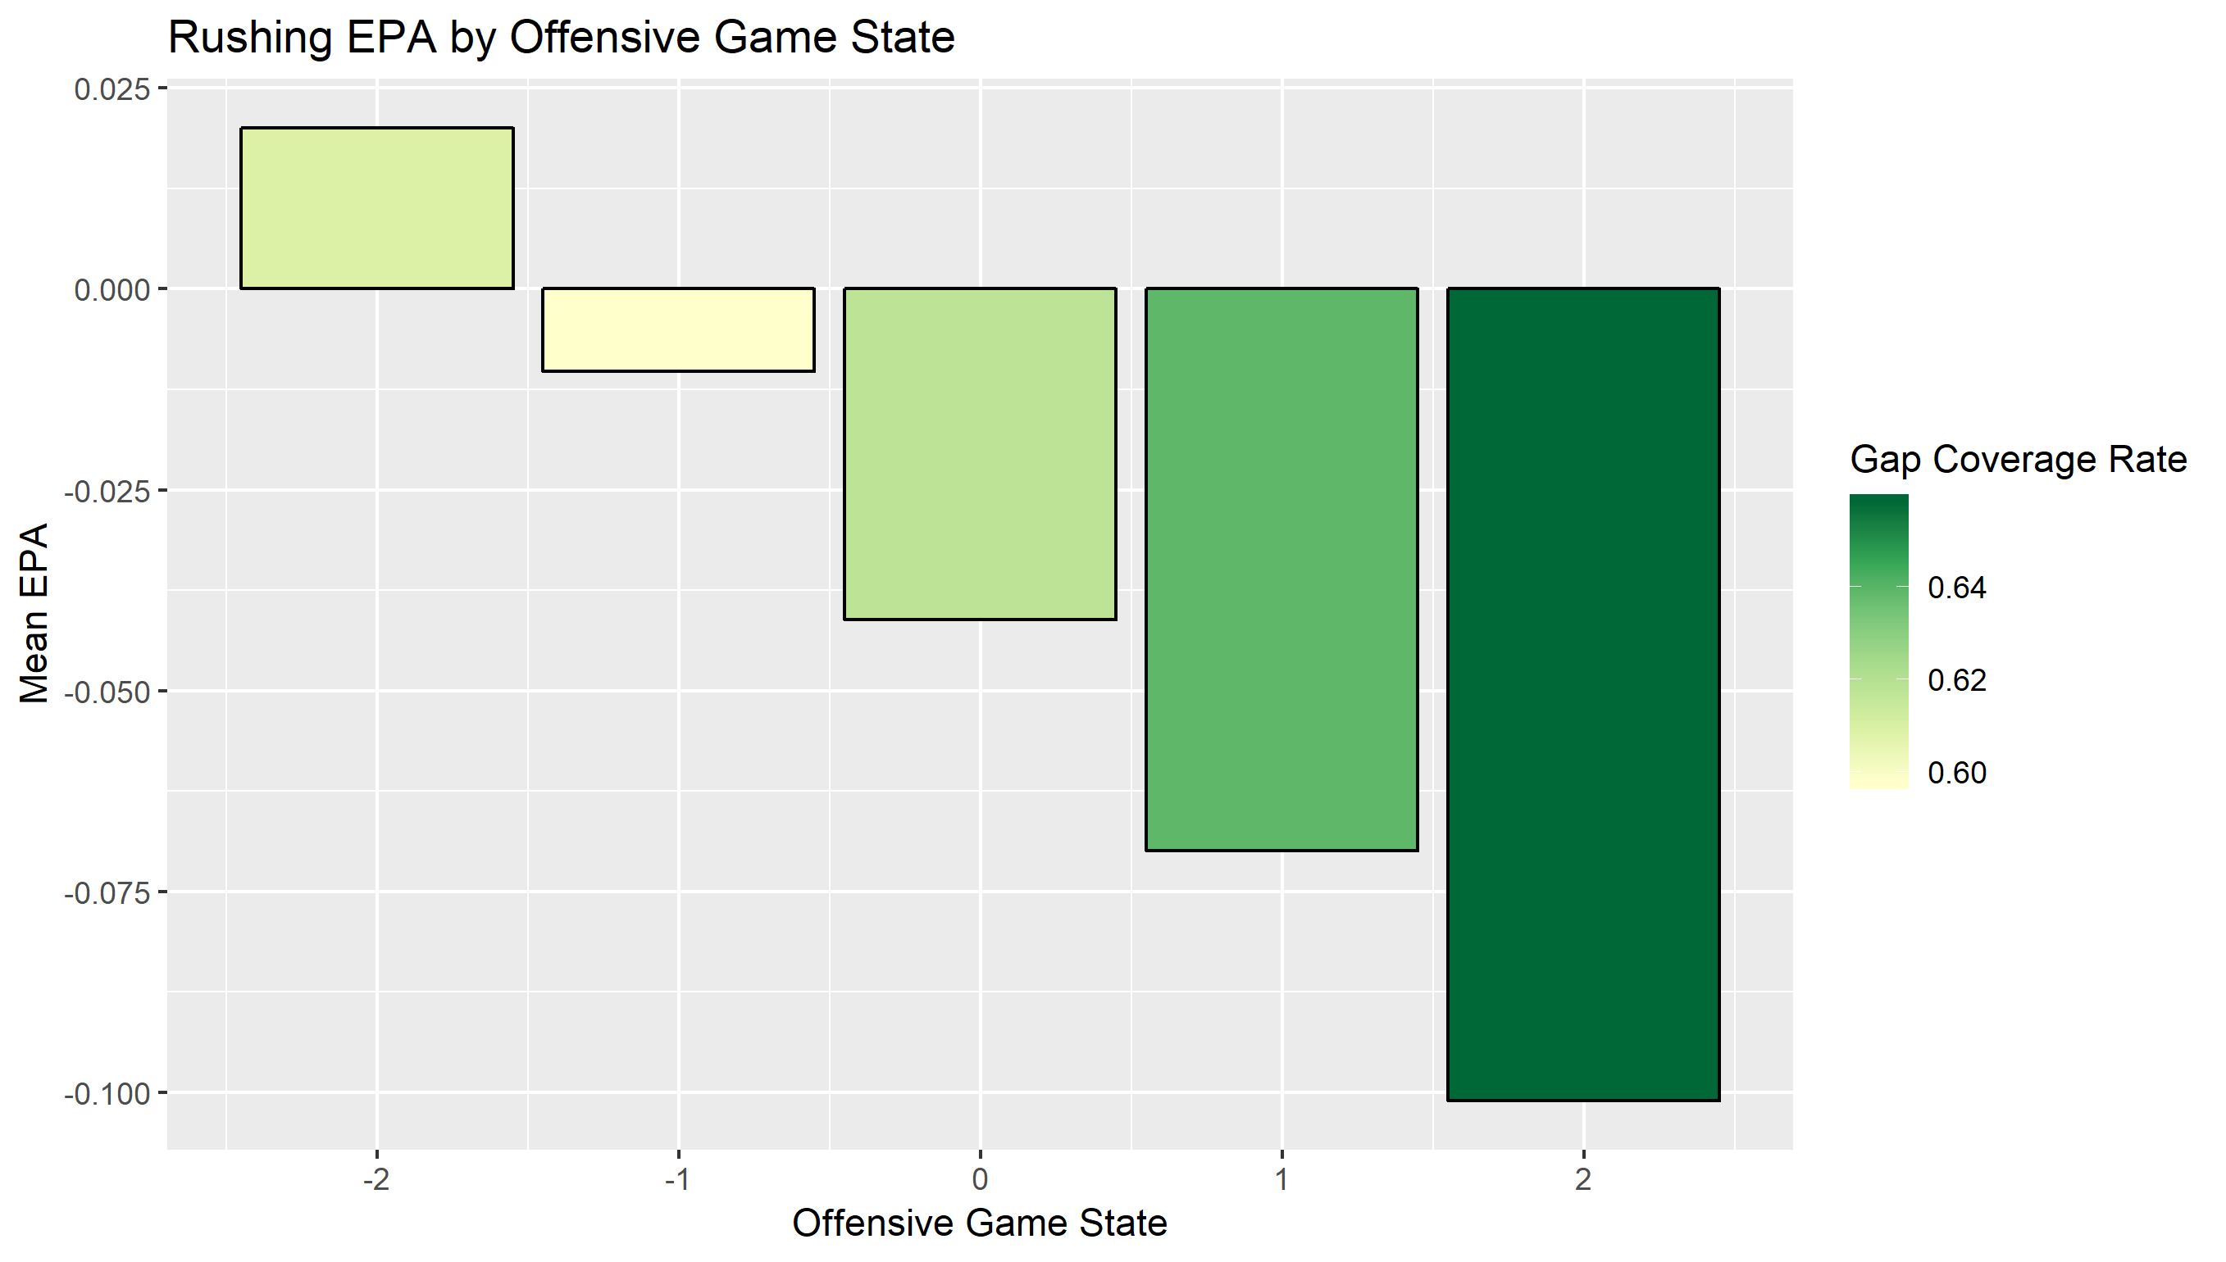
Effects of Game State
Conventional wisdom says to run the ball when you’re ahead. Defenses are aware of this and become better at stopping you
As game state improves for the offense, rush EPA gets progressively worse while gap coverage rates increase

Slide 27
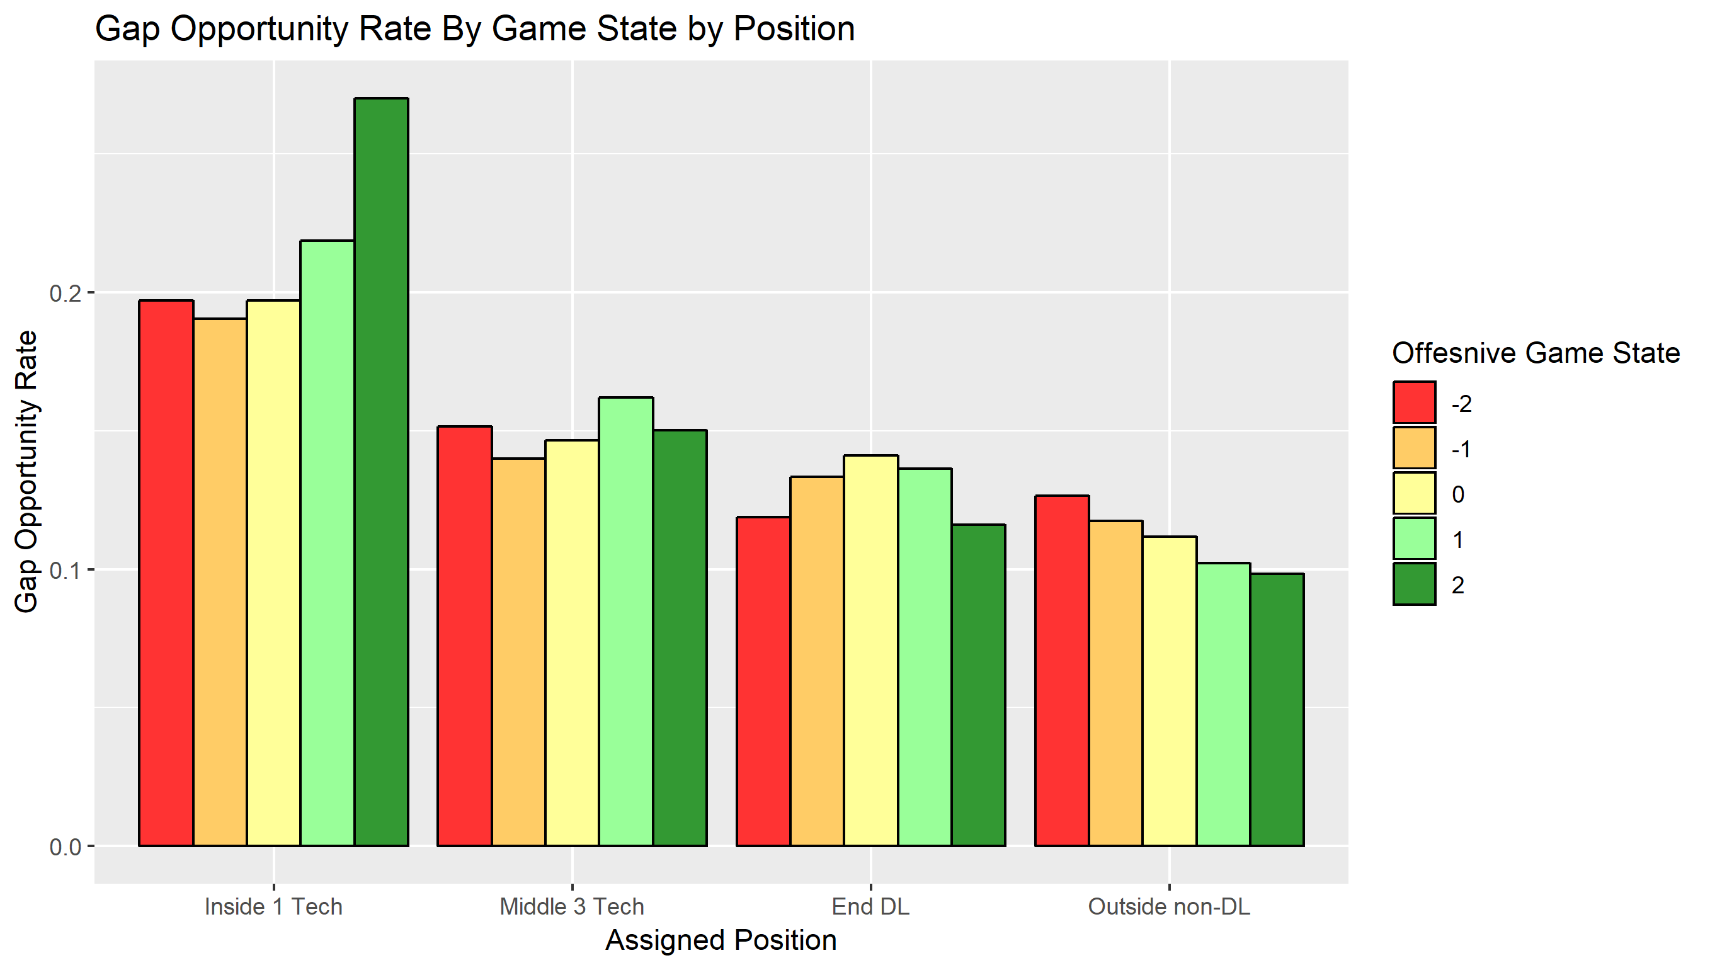
Positional Importance by Game State
Another finding using game state is the rate of gap opportunities for each position
A gap opportunity requires two things: the defense to line up a player in a gap and the offense to run at that gap
While most gap opportunity rates per position don’t vary too much by game state, it skyrockets for Inside 1 Techs when their team is behind
If you’re going to be in comeback mode, expect a lot of runs up the middle and have an Inside 1 Tech on the field to stop them

Slide 28
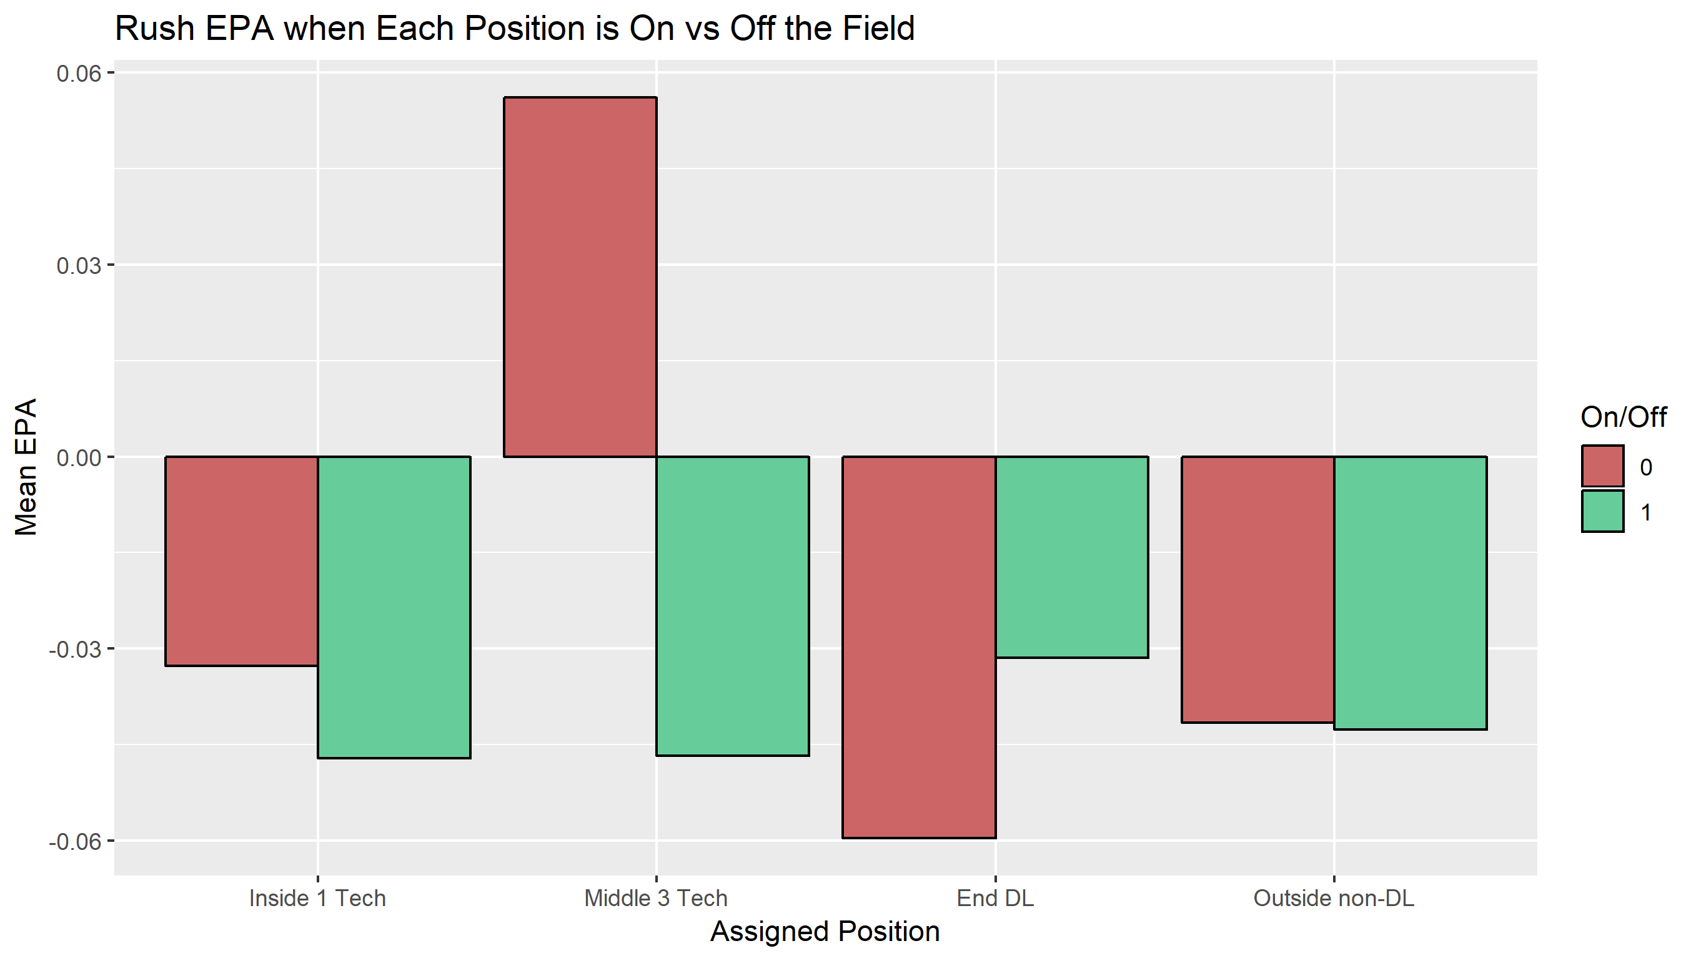
On/Off Splits
There’s so much to defensive line activity that isn’t captured in the box score. A player could occupy 3 offensive linemen allowing a teammate to make a tackle which goes totally unnoticed in the box score
One way to assess holistic performance is looking at EPA differentials for plays when at least one player from each position is on the field or none are
Clearly having a Middle 3 Tech on the field makes a huge difference. Teams know this too as no Middle 3 Tech’s is the smallest subset of plays
For rushing, a team is better off not having End DL’s on the field
Again it is worth noting these positions describe the players themselves, not where they line up on a play

Slide 29
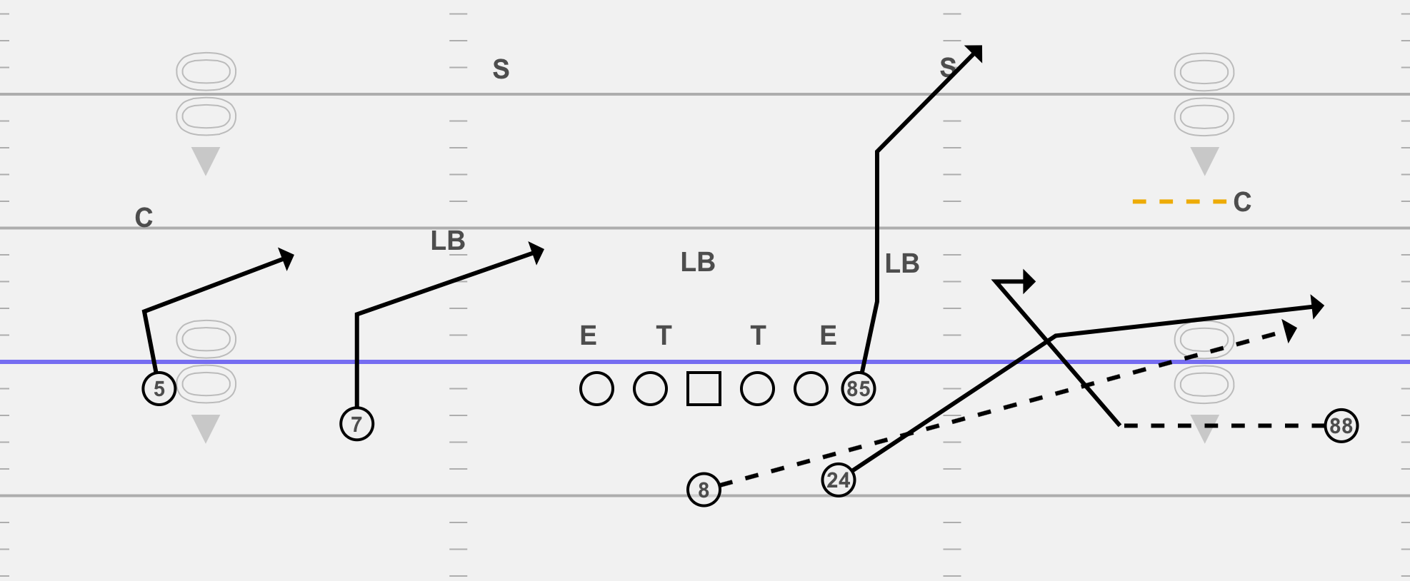
Passing Analysis

Slide 30
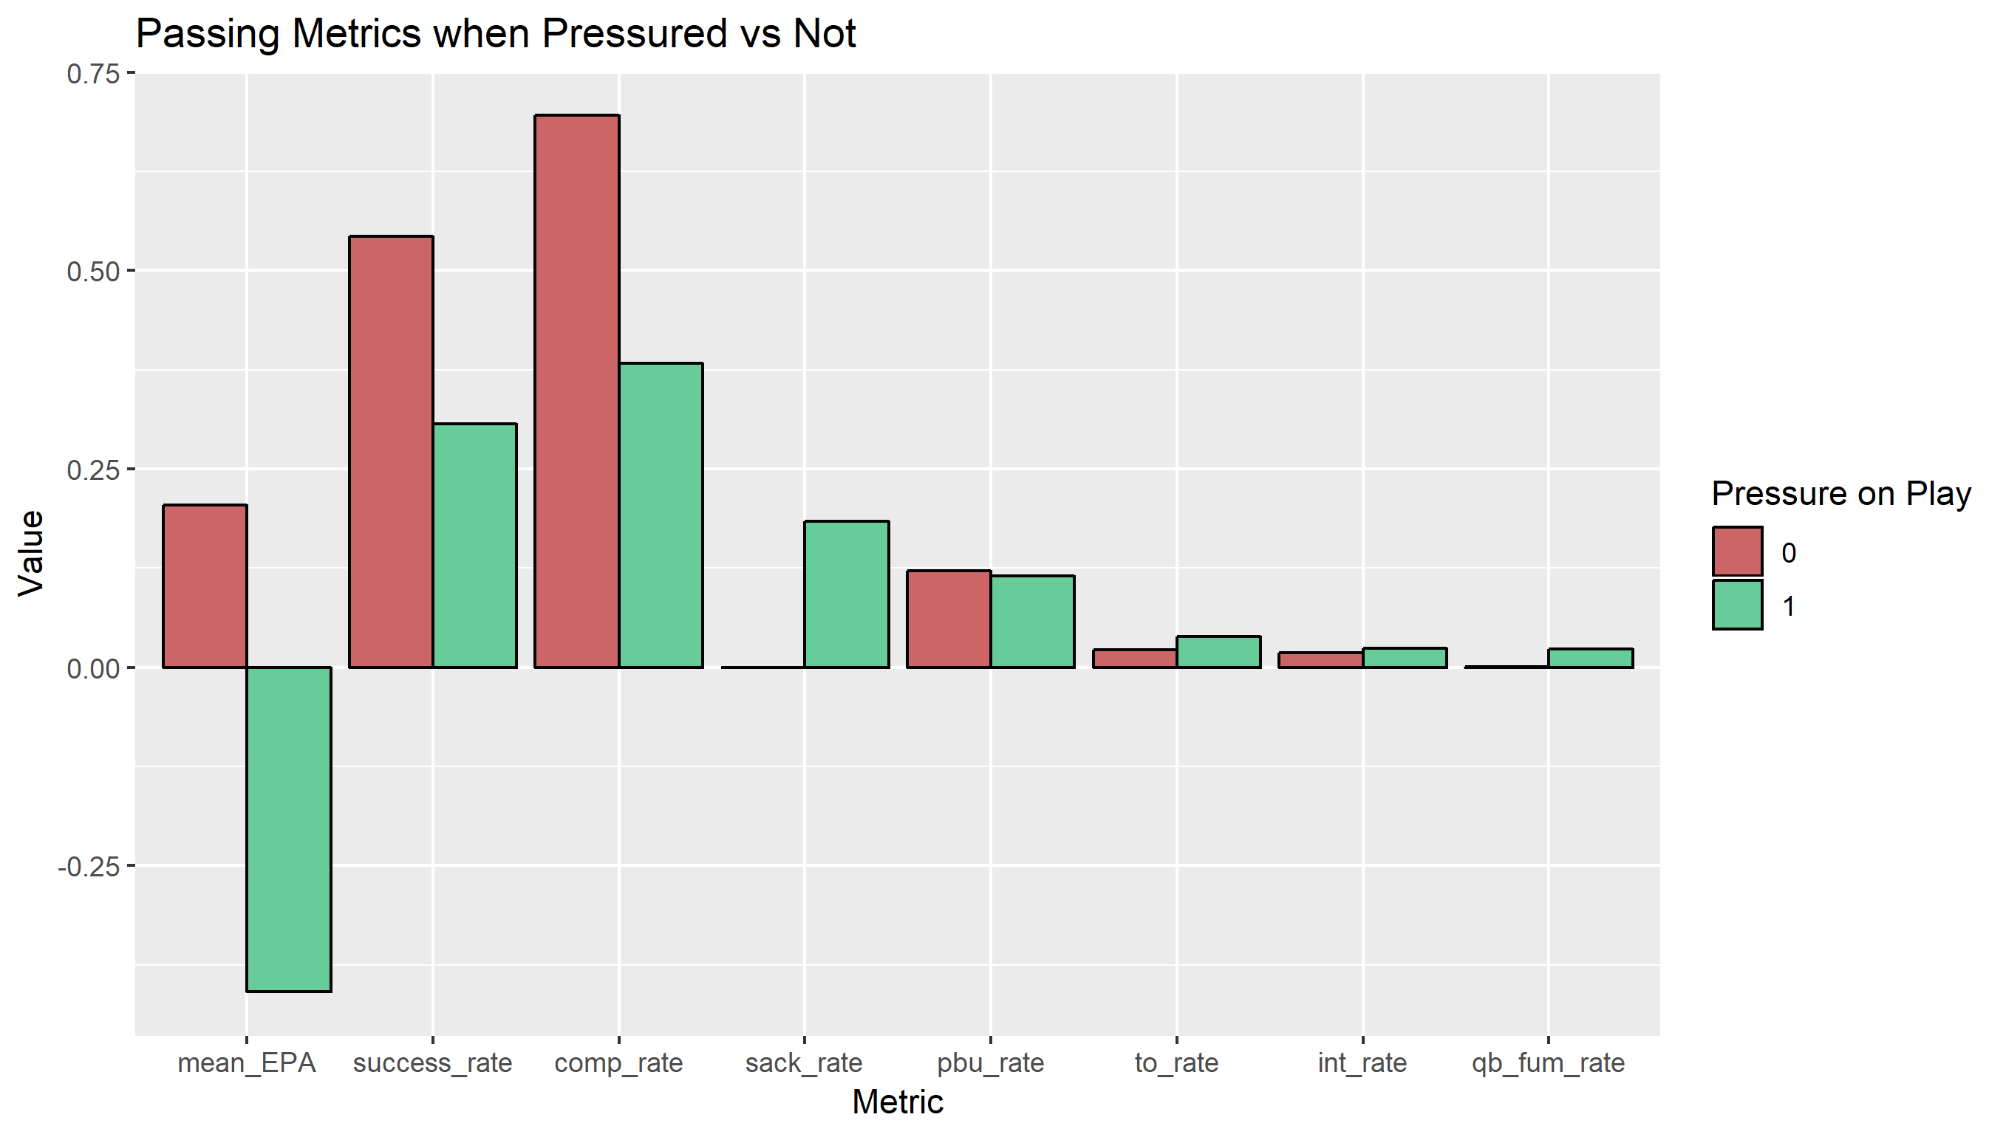
Pressure is King
In the passing game the defensive line’s best way to force a negative outcome is through pressuring the QB
Across the board bad things happen for the offense when the defense gets pressure
EPA craters, success rate and completion rate are nearly cut in half, sacks become possible, and turnover rates increase

Slide 31
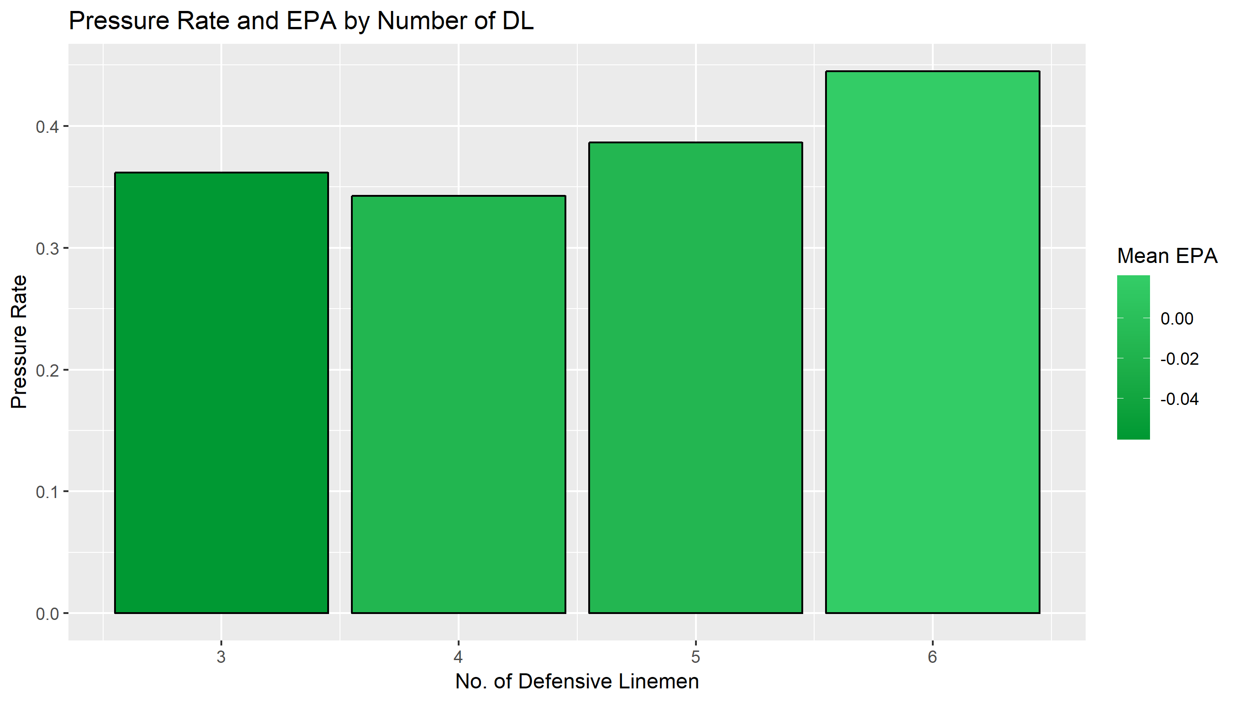
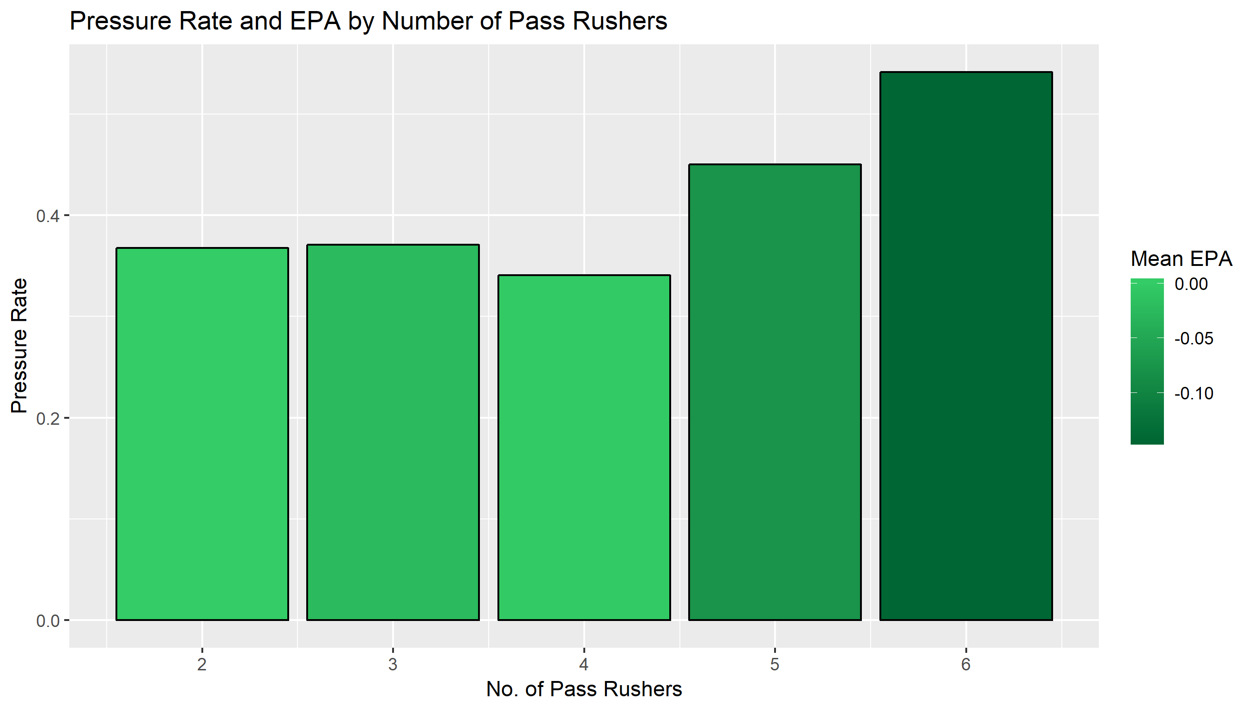
Pressure by Number of DL
As expected, the more DL’s on the field, the higher the pressure rate
However, additional DL’s come at the cost of help in the secondary. The marginal increase in pressure rate is offset in terms of average EPA given less backend help.
The key to minimizing EPA is blitzing (rushing 5+) or rushing 3 and dropping 8 into coverage
Rushing 4 results in the lowest pressure rates and worst EPA for defenses

Slide 32
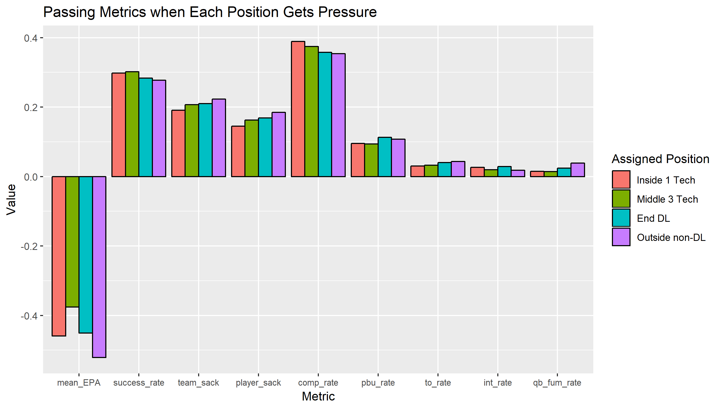
Pressure by Position
Not all pressure is created equally
Pressure from the outside, especially non-DL’s produces the best EPA, success rate, sack rate, and turnover rate
Across the board roughly 15% of individual pressures result in a sack by that player while 20% of plays with pressure result in a sack

Slide 33
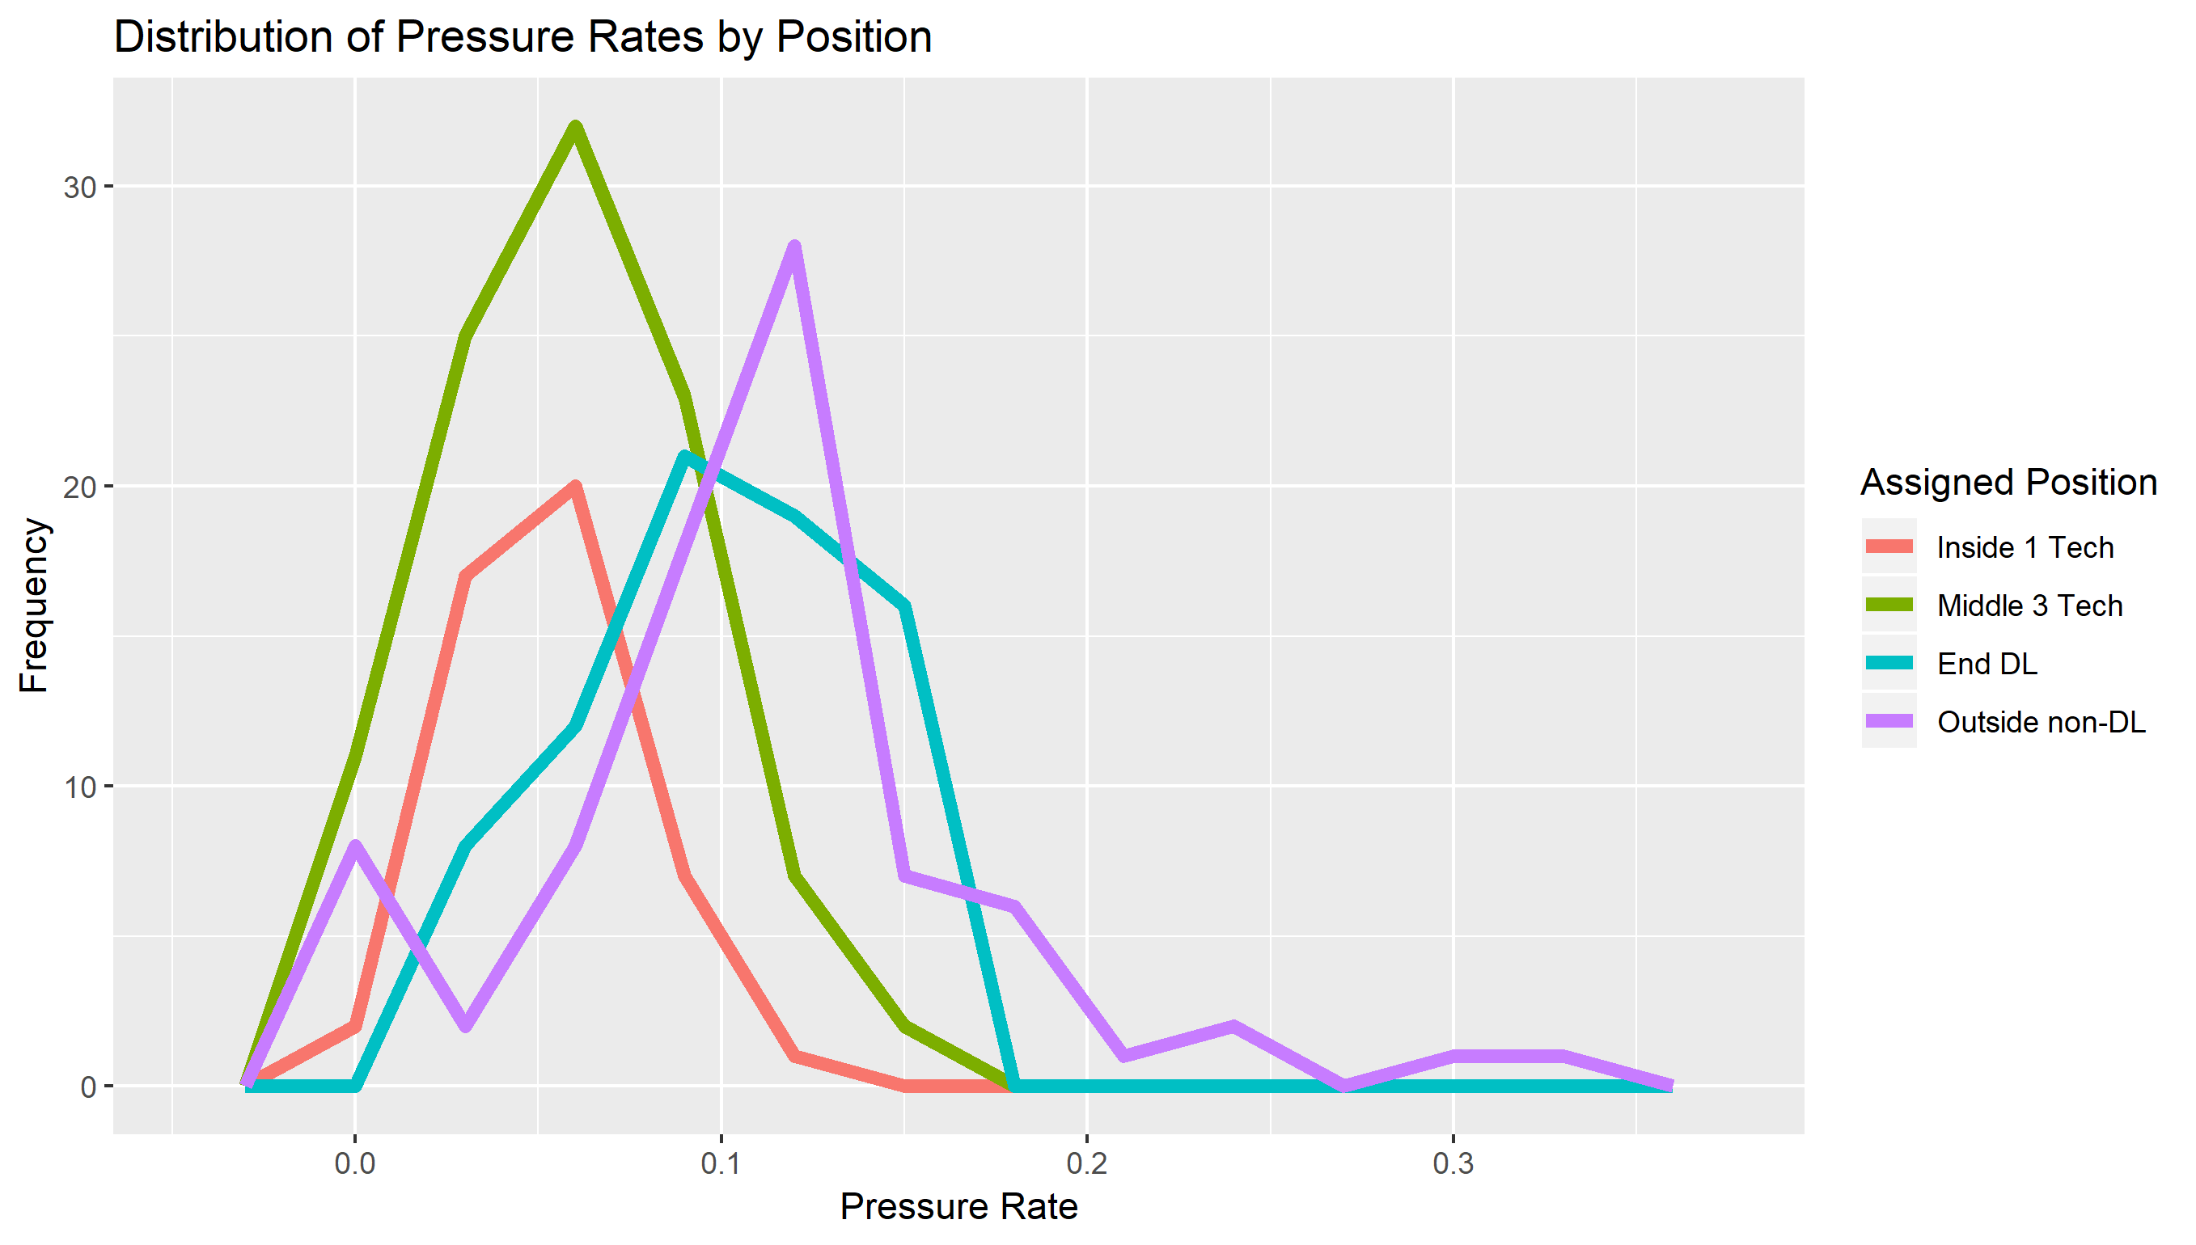
Positional Talent Distribution
Once again it’s key to see how the talent at a position is distributed in order to asses the marginal value investing in that position brings
For generating pressure, the End DL position has the widest range and Outside non-DL has the largest right tail of elite players
Interior positions are less differentiable in terms of pressure rates

Slide 34
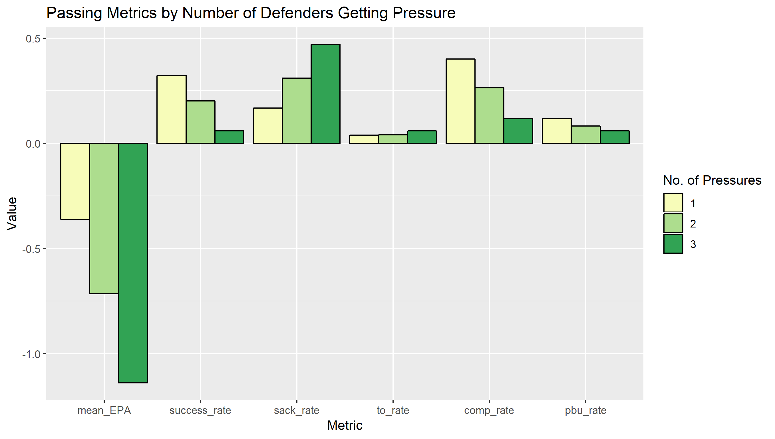
Pressure Stacks
We’ve shown how valuable it is to generate pressure
The effects are multiplied as the number of DL’s getting pressure increases
This supports the earlier finding that blitzes with 5 or 6 rushers result in the best EPA

Slide 35
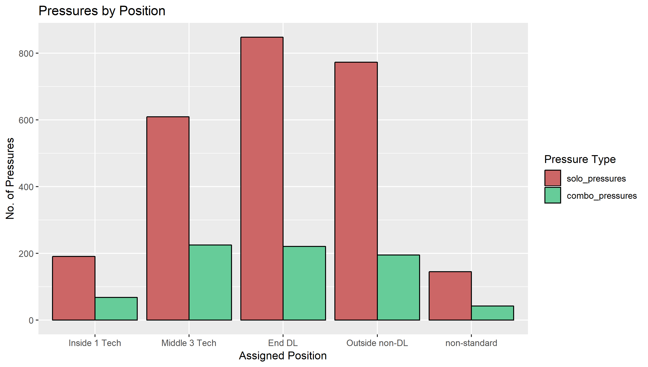
Combo Pressures
A combo pressure is a play where two or more DL’s generate pressure
Each position has roughly the same ratio of solo pressures to combo pressures (73-79% solo)
Outside players tend to be on the higher end indicating they are better at generating their own pressure

Slide 36
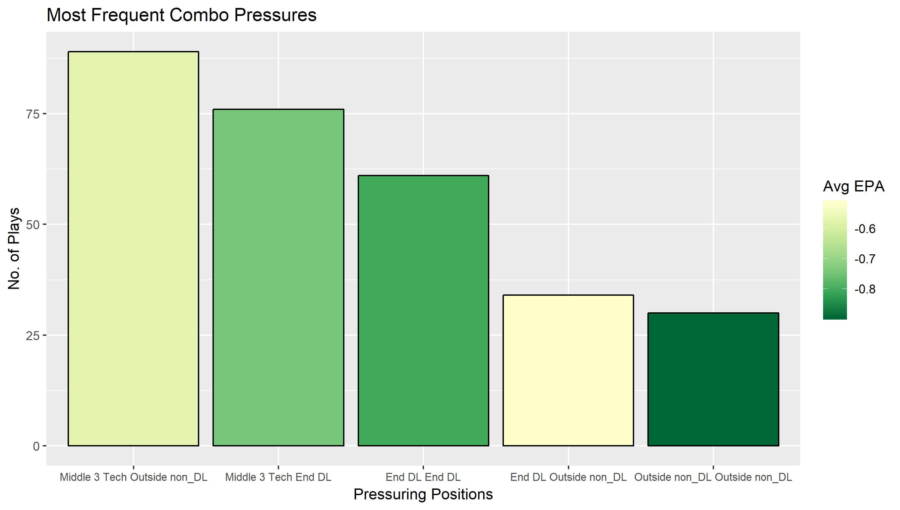
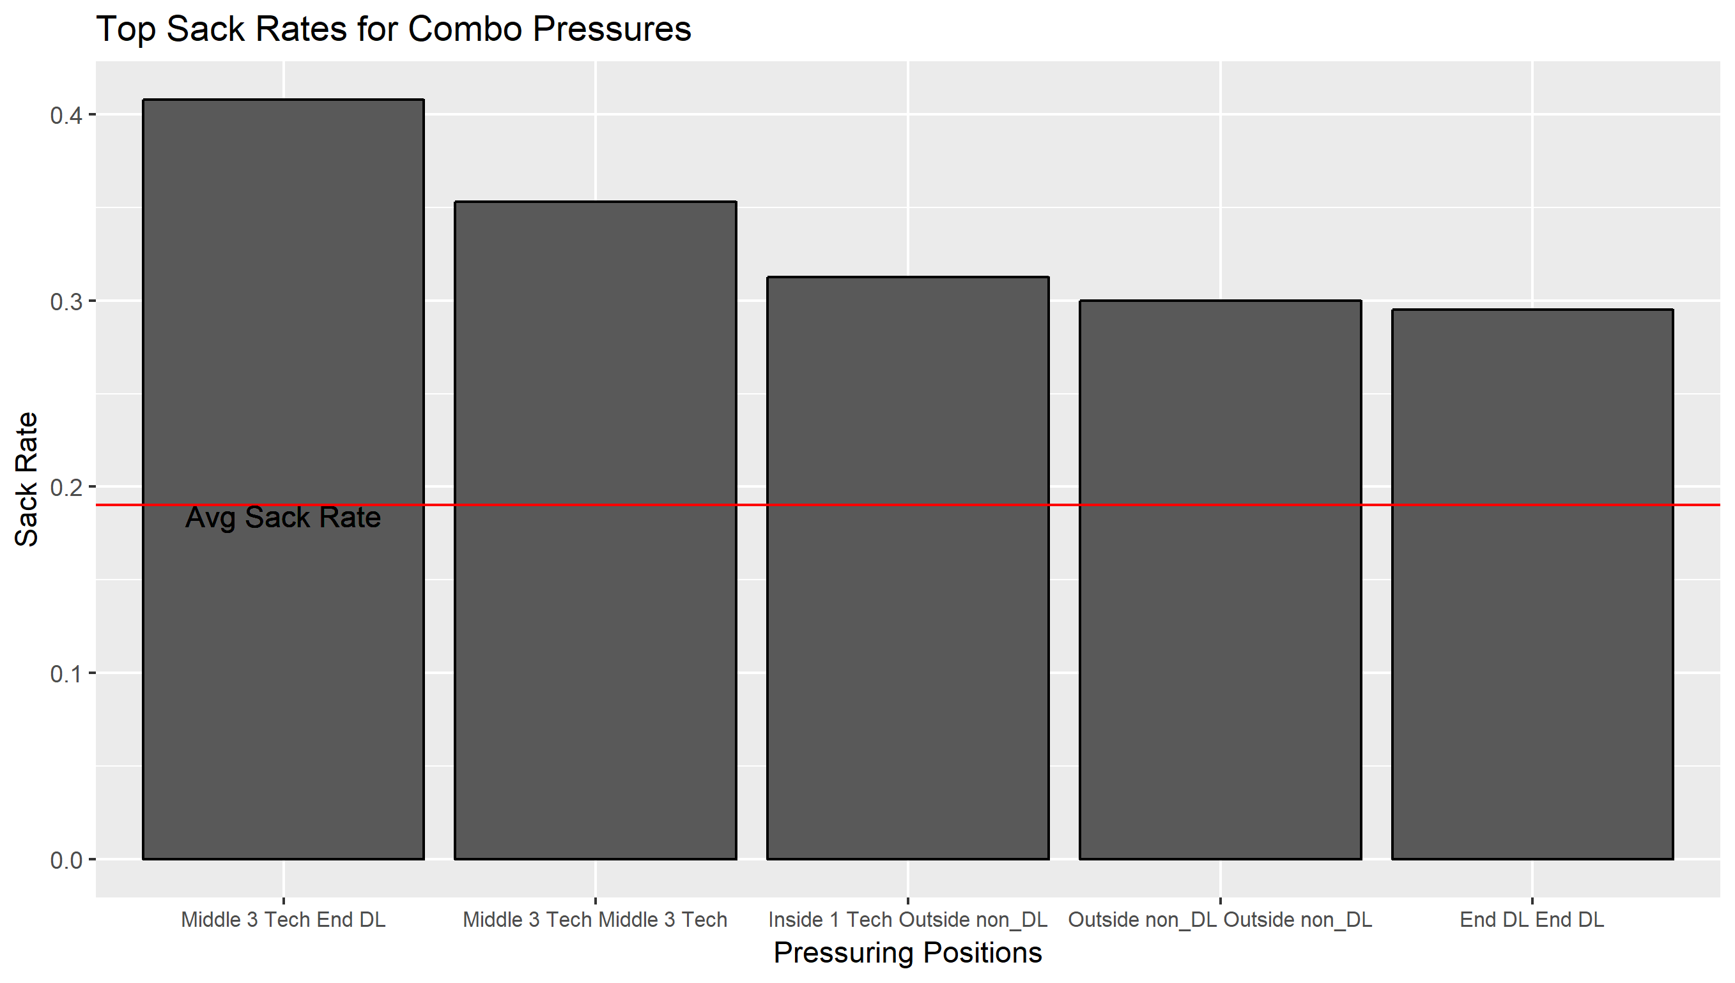
Specific Pressure Combos
The most common pressure combos involve a Middle 3 Tech and an outside rusher. Adding a Middle 3 pressure to an outside rusher pressure leverages the sack probability by about 2x

Slide 37
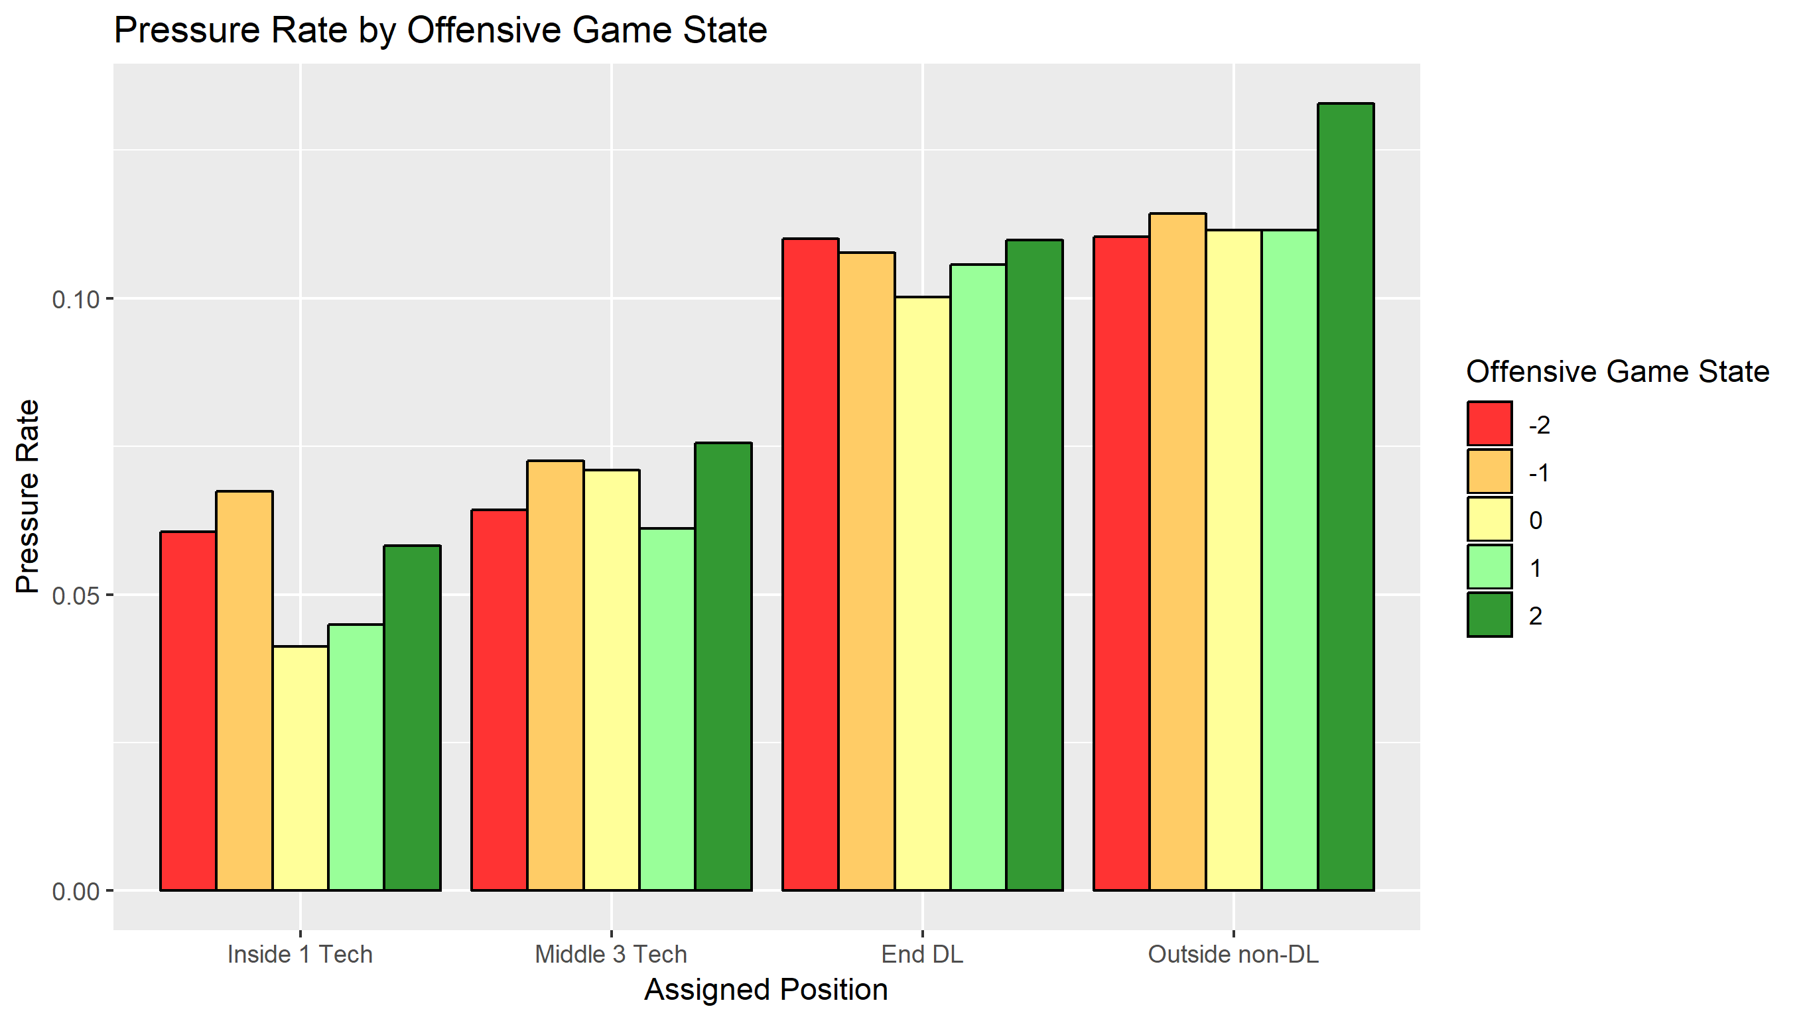
Game State Effects
Game state appears to have a weak effect on pressure rates for the positions
Inside 1 Techs get slightly more when their team is losing
Suggests they become more aggressive when needed
Outside non-DLs do more work when their team is winning
They know the offense is going to be throwing so can rush the edge with abandon
Interesting that End DL’s don’t see the same dramatic boost

Slide 38
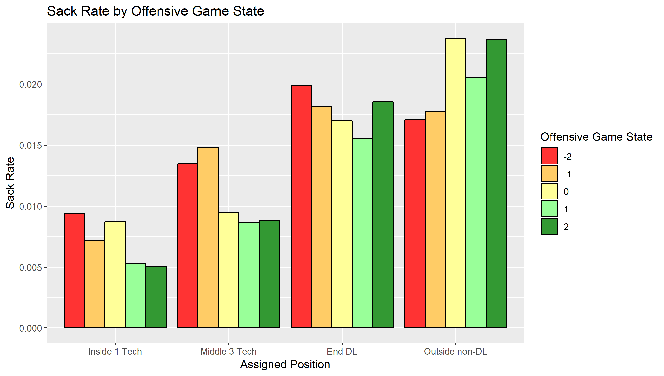
Game State Effects
We’ve shown sacks per pressure is fairly static across each position
There is a small sample size risk here, but game state appears to affect sack rate differently for the positions
When trailing the DL positions get more sacks while Outside non-DL sees jumps in neutral and positive game states

Slide 39
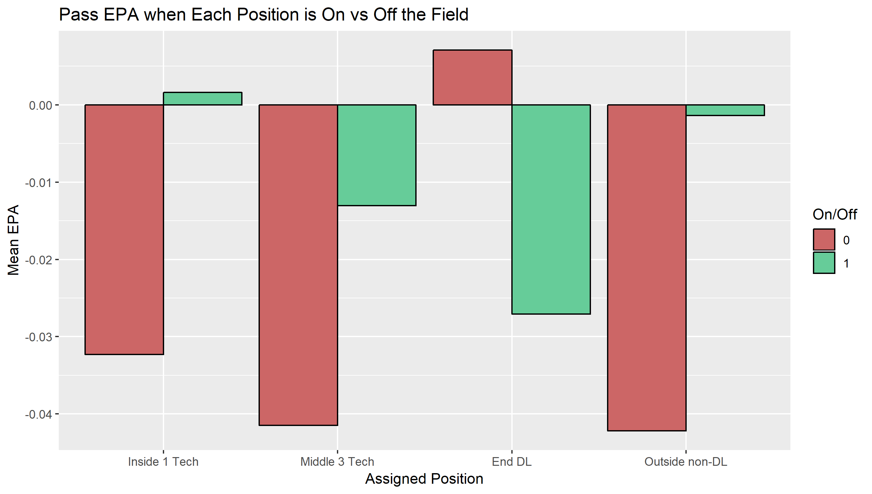
On/Off Splits
In the same vein as the rushing analysis, basic on/off splits can tell a more enriched story than specifics in the box score
For passing it appears having an End DL is the piece that swings defensive success
Middle 3 is the next best position when on the field, but it is interesting that the other positions look much worse being on than off

Slide 40
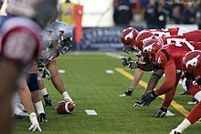
Conclusion

Slide 41
Conclusions
There are two main aspects of defensive line duties: passing game and running game
The different positions excel at different aspects
In the running game:
The Middle 3 Tech has the highest on/off differential and the widest distribution of forced gap changes
Suggests investing in an elite Middle 3 Tech will produce the best returns in the rush game
The Inside 1 Tech is the next most valuable based on on/off and gap opportunity rates when trailing
In the passing game:
End DL’s have the biggest on/off splits, the widest pressure rate distribution, and create among the most valuable pressures
Non-DL’s are also key pressure forcers
Middle 3 Tech’s provide solid support in the pass game by multiplying the effect of pressure when combined with outside rushers
Overall the data suggests Middle 3 Tech players provide the most differentiable value to teams

Slide 42
Limitations and Future Analysis
There are many opportunities to expand on this initial look at defensive line value
I would like to utilize a more nuanced game state approach than the rudimentary static score differential.
Win probability ranges would provide more accurate groupings for plays
At the onset I was excited to work with prediction models at the individual player level to see how players perform vs expected average performance. Nothing I tested provided a meaningful look in this timeframe
Number of linemen, combinations of techniques and positions were not effective in predicting EPA
The bulk of the run game analysis was based on the assumption that each player is responsible for his gap, no more no less, and the goal is to binarily force the rusher to another gap. Tracking data would’ve provided an incredibly rich resource to show offensive line engagement and displacement, running back path variation, and quarterback pocket activity

Slide 43

About me
Hi, my name is Taylor Williams. I’m an avid football fan and aspiring data nerd. I’m currently a part time student getting my Masters of Science in Analytics at the University of Chicago. I expect to graduate in June of 2021
My email: taylorjwilliams31@gmail.com
My GitHub: https://github.com/tjwillz31
My Twitter: https://twitter.com/tjwillz31

